Slide 1
Connecting Renewables
Climate Week New York
Patricia Labra
September 2023

Slide 2
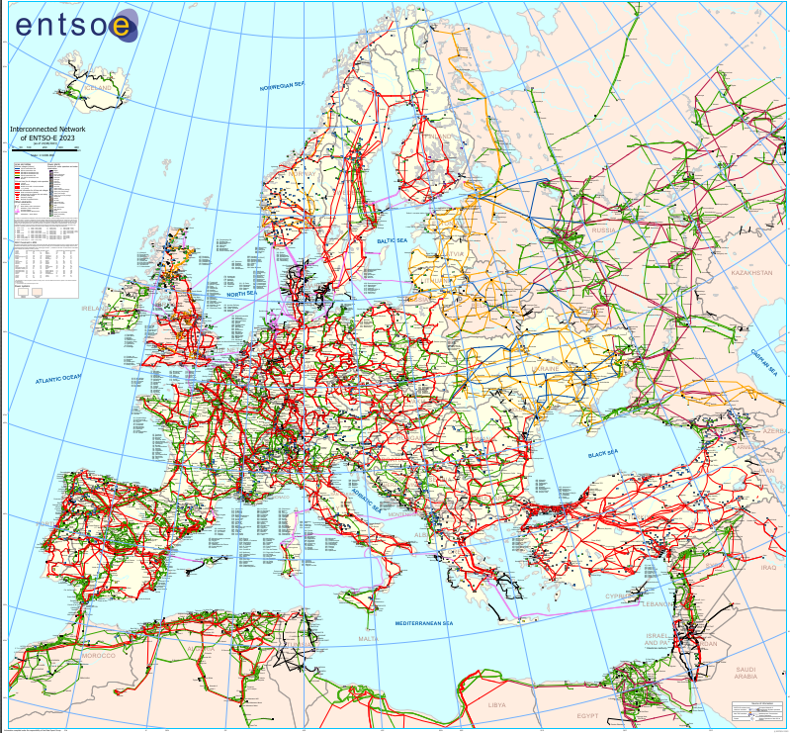
Context
National context
Red Electrica as Spanish TSO: Transmission System Operator
System Operator
Guarantees the continuity and security of electricity supply
Sole transmission Agent
Designs, builds and maintains the transmission network and facilitates transmission grid access
Government is responsible of the Energy policy, including the National Development Plan
SDC –October 2022

Slide 3
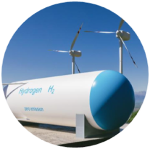


Spanish National Energy and Climate Plan (NECP) approved by the Government in 2020
Main goal is to reduce greenhouse gas emissions in the Spanish economy by at least 23% by 2030 compared to 1990, by means of …
42% of renewables in final energy consumption
74% of renewables in electricity sector
39,5% of reduction of primary energy consumption

Slide 4
Spanish National Energy and Climate Plan (NECP) approved by the Government in 2020
Main goal is to reduce greenhouse gas emissions in the Spanish economy by at least 23%→ 32% by 2030 compared to 1990, by means of …
42%→ 48% of renewables in final energy consumption
74%→81% of renewables in electricity sector
39,5%→ 44% of reduction of primary energy consumption
With a proposal of revision in June 2023
Notes:
And reduce Energy dependence from 61 to 51%

Slide 5
Installed Generation Capacity from today to 2030
Installed capacity (31.12.22)
Installed capacity
(Peninsula):
109.341 MW
Installed capacity
(Peninsula):
203.649 MW
Peak Demand
38.000 MW
Peak Demand
51.450 MW
∑ Renewable Capacity ≈ 62,6%
∑ Renewable Capacity ≈ 76%
Notes:
Sept 2022→ Eolica 29700 and solar 22000 ( almost 2,5 GW more)

Slide 6
Generation Balance from today to 2030
Generation Balance 2022
∑ Energies with zero CO2 emissions ≈ 66,0 %
∑ Renewable energy ≈ 44,3%
∑ Renewable energy ≈ 81%
TOTAL Demand : 235.459 GWh
TOTAL Demand : 316.5 GWh

Slide 7

3.
Operation – how we succed in integrating >40% RES

Slide 8


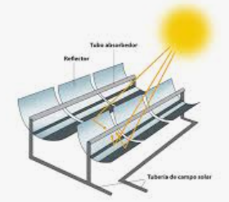
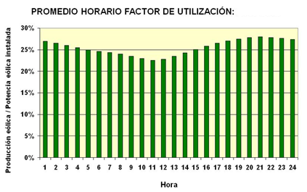
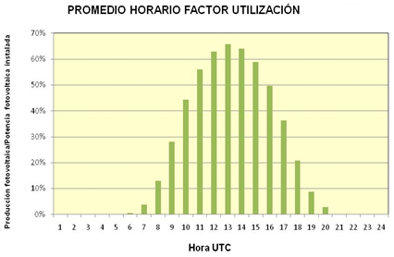
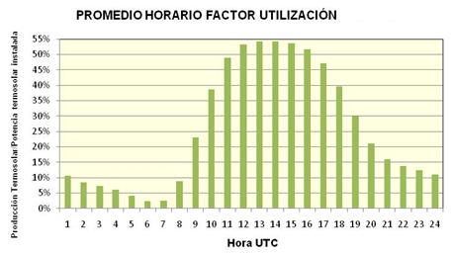
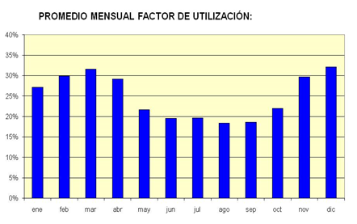
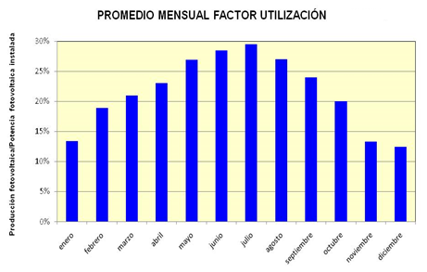
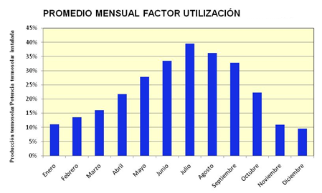
Primary resource variability
Hourly average utilization factor
Hourly average utilization factor
Hourly average utilization factor
Hourly averae utilization factor
monthly average utilization factor
monthly average utilization factor
monthly average utilization factor

Slide 9
Tool kit in Operation
Forecast
CECRE
SRAP
Provision of services

Slide 10
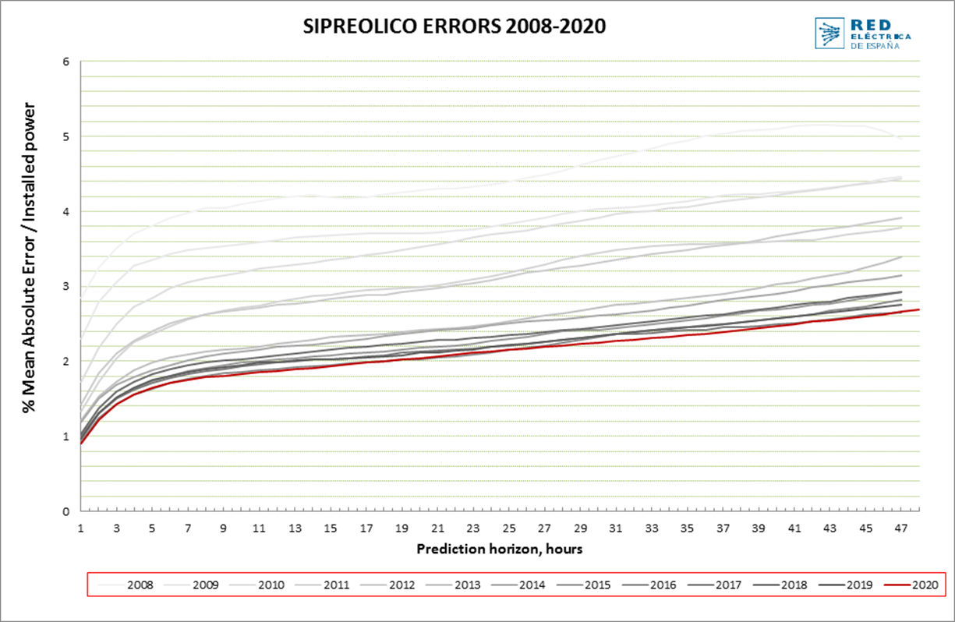

Continuous adaptation of the forecast models
Forecast
RES Forecast
Demand Forecast
Reduction of error during the last decade
10
Notes:
Self consumption – relevant for demand

Slide 11
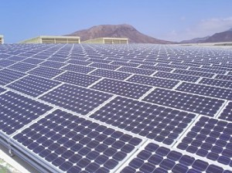
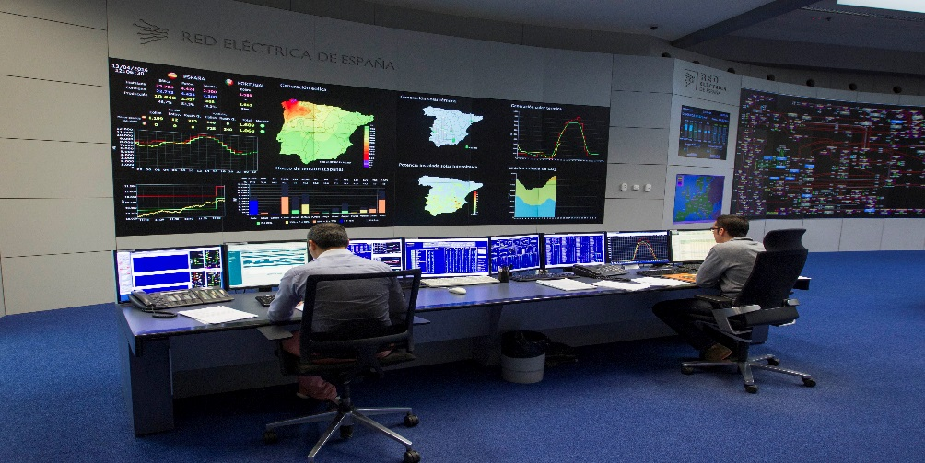


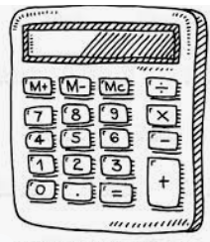
CECRE: Renewable Energy Control Centre
  Pioneer and reference center worldwide in the integration of renewable energies, cogeneration and waste, commissioned in 2006
CECRE
P > 1 MW
Facilities or Agregations
P > 5 MW
Through a Control Center for Gen&Deman
Through a Control Center for Gen&Deman
CECRE
  Observability
  Observability & controllability
Carry out reliable production forecasts
Manage congestion in the generation evacuation
Manage generation-demand balance
Minimize risks to transient stability
Perform network state estimation and congestion analysis
Minimize generation surpluses that cannot be integrated into the System
11

Slide 12


Automatic Power Reduction System (SRAP)
SRAP
How does it work?
  Send signals to reduce generation after predefined events in the grid (contingencies).
  New operational tool, integrated in the control system in 2022 that allow to send signals in case of events in the transmisión network: it reduces power plants after N-1 in down to 3 seconds
SCADA NUDO 2
ICCP 1
NUDO 1
NUDO 2
Reduction signal
Scada OS
SCADA NUDO 1
ICCP 2
Reduce needs of RES limitation pre-contingency
More flexibility for the devices to reduce congestions post-contingency
Maximize RES integration and use of the grid
SDC –October 2022

Slide 13
Adaptation of Operational Procedures to RD 413/2014
Take the opportunity to integrate RES as an energy with possibilities
Provision of services
Participation in Ancillary Services
Participation in voltage control
Renewable facilities >= 5 MW must comply with the power factor instructions that the OS defines within the following range::
Relevant for Demand Coverage
Possibility of Renewable facilities, after passing enablement tests, to participate in the following ancillary services:
    Replacement Reserves
    Tertiary
    Secondary
Therefore, Renewable facilities are allowed to participate in ancillary services, as long as they pass service-specific prequalification tests
0.98
1.00
0.98
Inductive
Capacitive
Annex III defines a penalty of 0,261 c€/kWh in case of non-compliance
Future Voltage control: Service providers that will follow real time setpoints (U, Q, power factor)
RD 413/2014: Article 7

Slide 14
1.
Future challenges and solutions

Slide 15

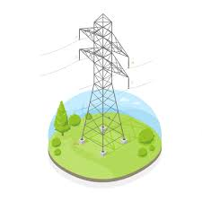
System Adequacy
Generation Adequacy
Network adequacy
Is demand in every hour properly covered ?
Is current network sufficient to accomodate future scenarios of demand and generation?
Demand
Production
Storage
Storage
Market curtailments
Capacity Mechanism
Flexibility also for demand → SRAD
Restoration of the system
Technical Curtailments
Technical restrictions
Stability
→ Identification of system needs and Solutions
SDC –October 2022

Slide 16

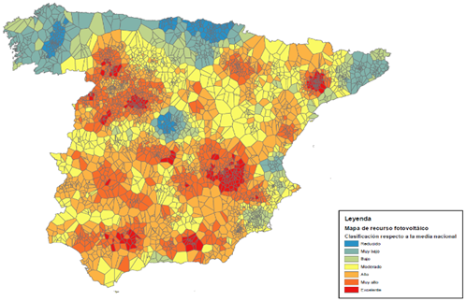
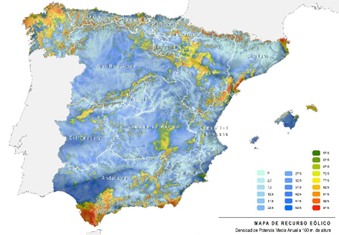
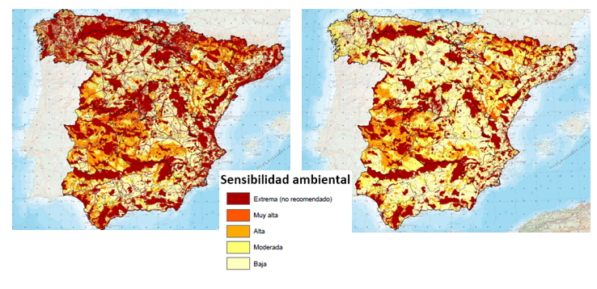

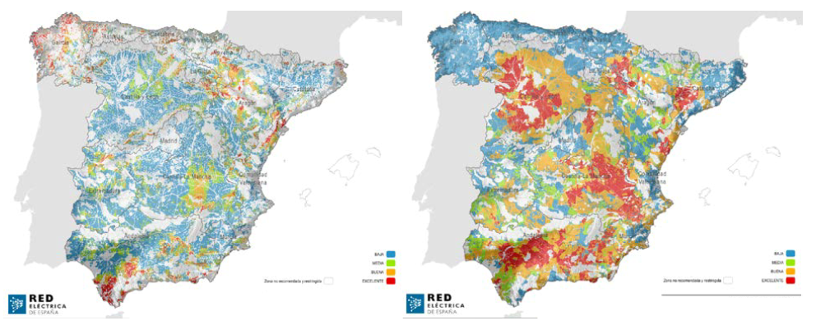
Network adequacy- Where is the generation located?
Wind Expectations →x 3 NECP target values
Solar PV Expectations → x 13 NECP target values
RESOURCE MAPS
ACCEPTANCE MAPS
Wind Resource Map IDAE
FV Resource Map REE
Environmental zoning for the implementation of RES (MITERD)
STK INTEREST
FV
WInd
FV
Wind
Sucess probability index
FV
Wind
SDC –October 2022
Notes:
Probability of sucess Maps combine Resource, Efficiency and ease of environmental permitting
Desarrollo de una metodología novedosa basada en pilares de sostenibilidad:
promoción de renovables en base a recurso, primando eficiencia y respeto al medio ambiente
Demanda peninsular:
Valor > en un 4,0 % a la demanda real del año 2019 (valor de 249,1 TWh)
Valor < en un 9% a la demanda central estimada para 2020 en el ejercicio de Planificación 2015-2020. La disminución de demanda prevista a futuro se deriva de las medidas de eficiencia.

Slide 17
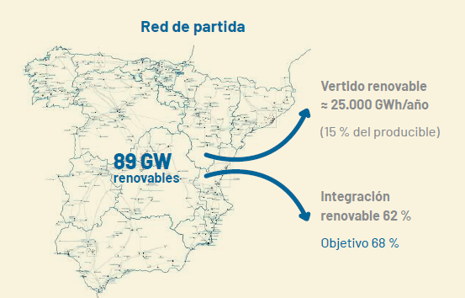
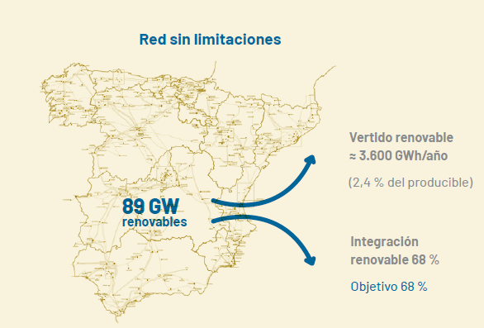
The grid as an enabler of the Energy transision
Balance between a Starting grid & a no limitations grid
Starting grid
No limitations grid
Starting grid
Curtailment
15%
Curtailment
2,4%
RES
62%
RES
68%
SDC –October 2022
17

Slide 18
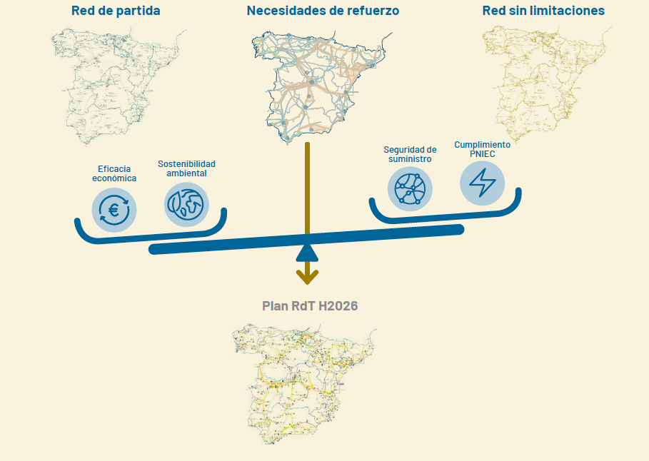
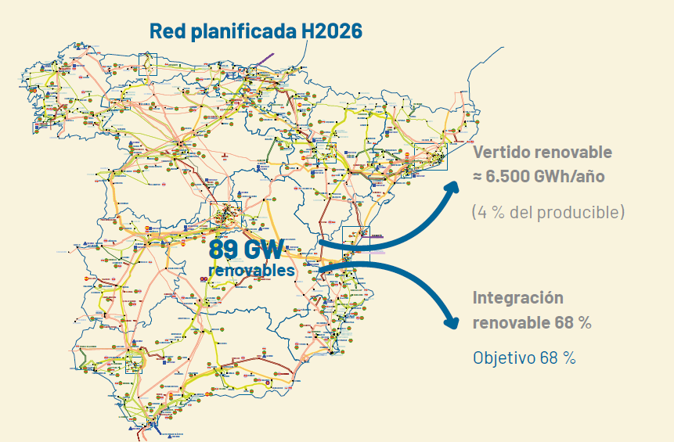
The grid as an enabler of the Energy transision
Balance between a Starting grid & a no limitations grid
Starting grid
No limitations grid
Starting grid
Curtailment
System needs identification
Curtailment
15%
Curtailment
2,4%
RES
62%
RES
68%
RES
Planned grid
Planned network allows balance among the objectives of the Energy policy, security of supply, economic sustainability and environmental compromise
Curtailment
(*)
4% *
RES
68%
SDC –October 2022
18
(*) Coherent with(Art.13.5 Ref(UE) 2016/943

Slide 19
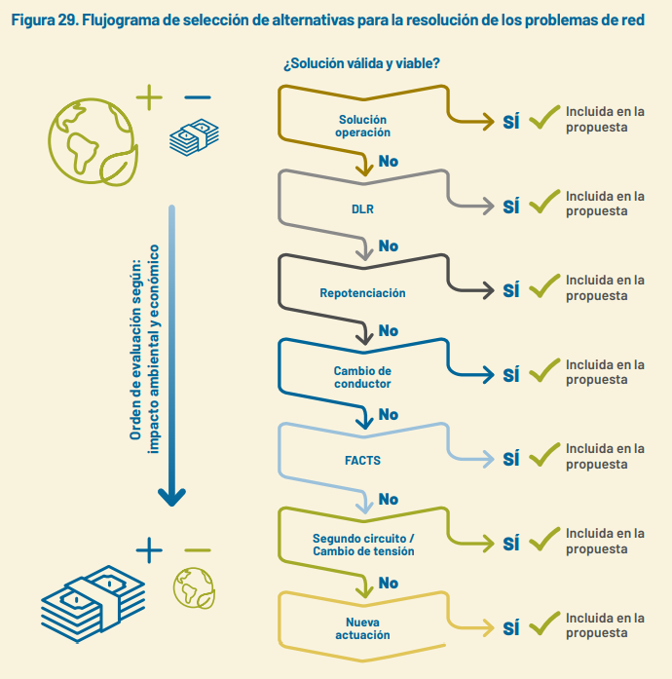
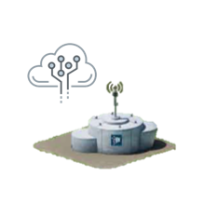
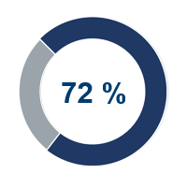
Decision flowchart based on EE1 (energy efficiency principle)
The choice of solutions to solve future network needs prioritise the use of existing network
¿Does the solution suit the need? ¿Is it feasible?
Operational solution
Yes
New operational tools and communications solve 80% of contingency problems
Dynamic Line Rating
Yes
Included in NDP
Line uprating
Yes
Included in NDP
Environmental and economic impact
Reconductoring
Yes
Included in NDP
Yes
Included in NDP
72 % of actions in the NDP focus on improving and maximising the use of existing lines, that is minimising environmental impact
FACTS
Upgrading
Yes
Included in NDP
New assets
Yes
Included in NDP
SDC –October 2022

Slide 20
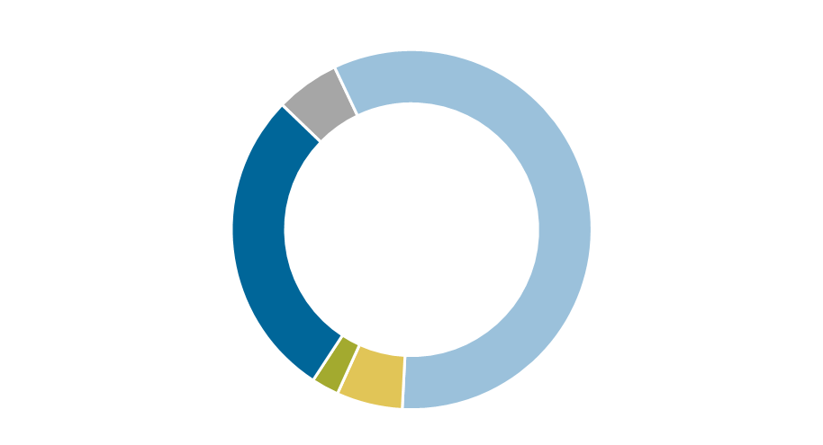

Efficiency principle
The choice of solutions to solve future network needs prioritise the use of existing network
¿Does the solution suit the need? ¿Is it feasible?
700 km
renewals
Operational solution
Yes
7.057 km
upratings
2.681 km
New aerial ROW
New operational tools and communications solve 80% of contingency problems
Dynamic Line Rating
Yes
Included in NDP
734 km
Submarine link
Line uprating
Yes
Included in NDP
300 km
reconducting
722 km
DLR
Environmental and economic impact
Reconductoring
Yes
Included in NDP
Yes
Included in NDP
72 % of actions in NDP focus on improving and maximising the use of existing lines, that is minimising environmental impact
FACTS
Upgrading
Yes
Included in NDP
New assets
Yes
Included in NDP
SDC –October 2022

Slide 21
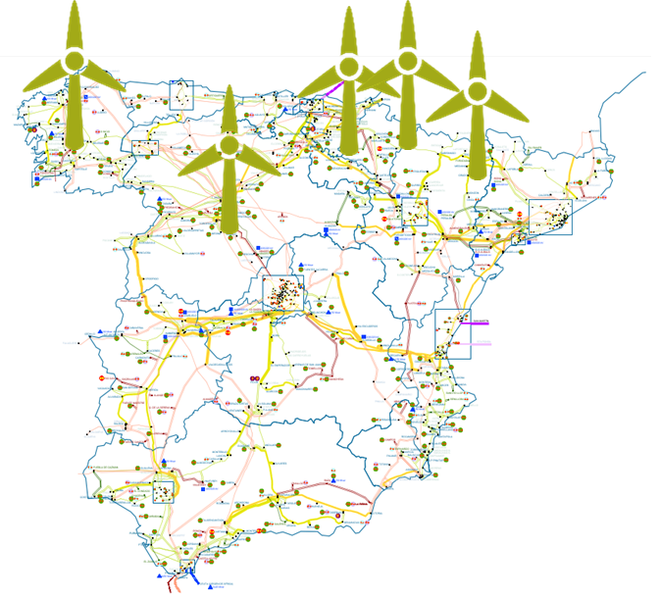
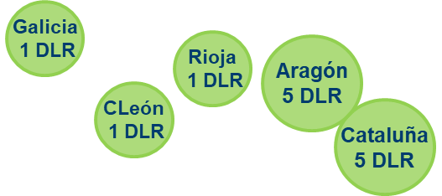
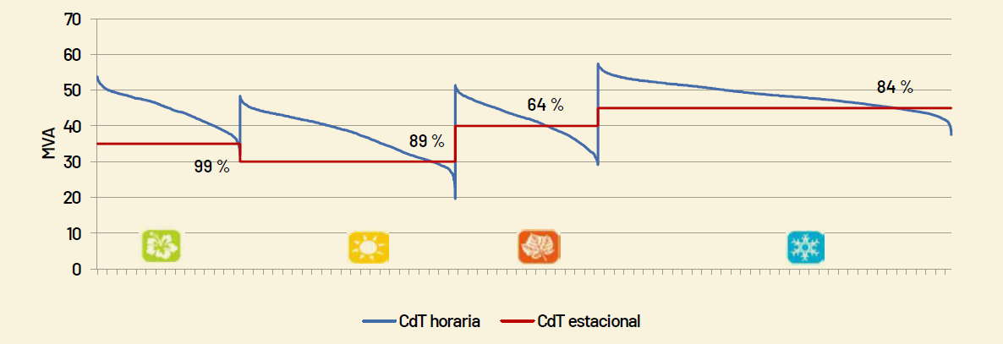
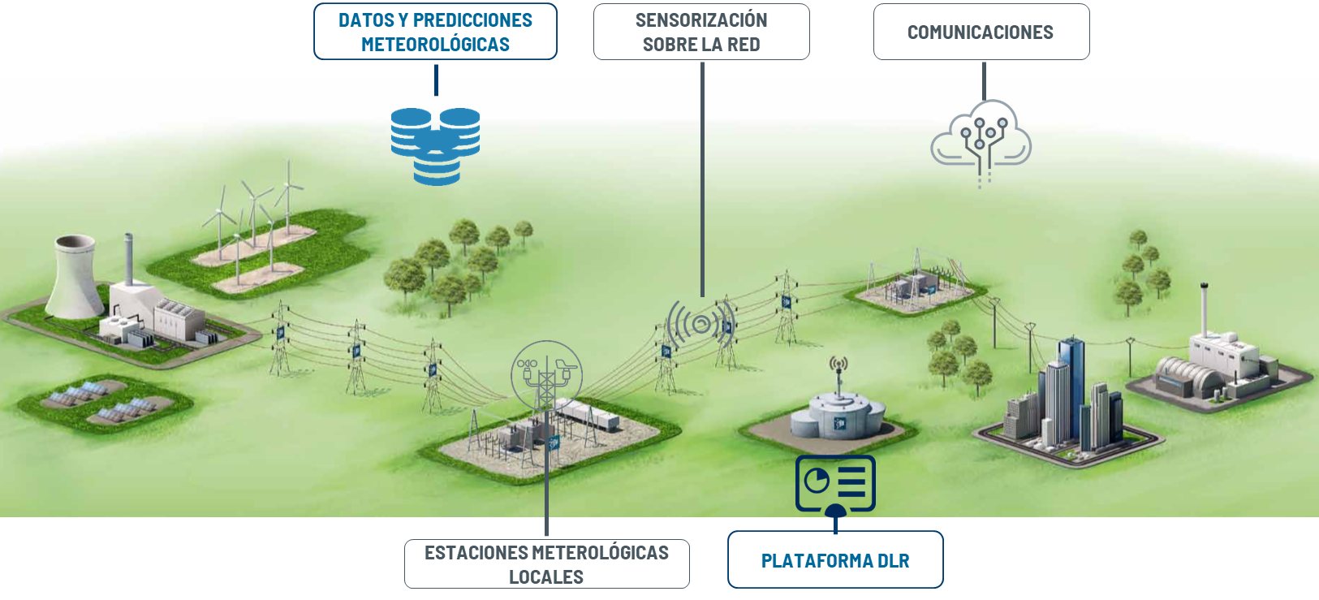



Toolbox. Tecnological solutions (DLR)
Static Capacity
Seasonal Capacities
(4 annual values)
Dynamic Capacity
Transmisssion Capacity values computed in real time
722 km
DLR allows higher use of existing network in those moments when climate conditions are favorables
Climate variables
23 lines
TEMPERATURE
IRRADIANCE
WIND
SDC –October 2022

Slide 22

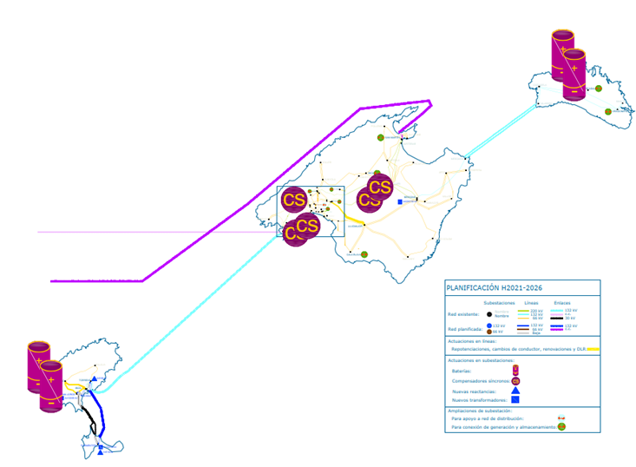


Toolbox. Tecnological solutions (batteries and syncronous condensers)
Submarine HVDC Link (2x200MW)
50 MW
37,5 MWh
2nd link Spanish Mainland –Balearic Island
2 storage systems as fully integrated network elements
(batteries in Mercadal -50MW and San Antonio -90MW)
Batteries are only prepared for use in case of emergency
90 MW
67,5 MWh
5 syncronous condensers as fully integrated network elements (in Llubí, Sta Ponsa & Valldurgent)
SDC –October 2022

Slide 23
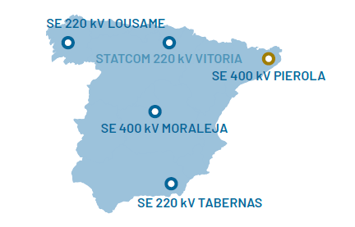
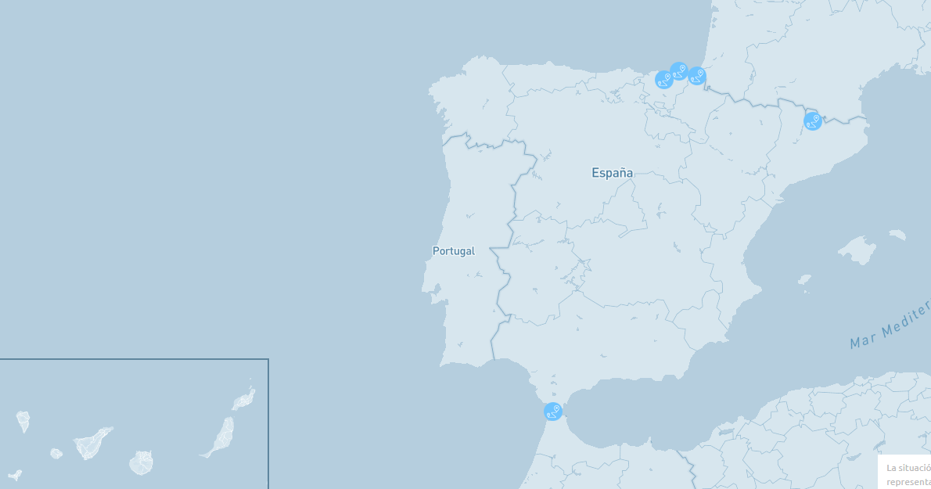




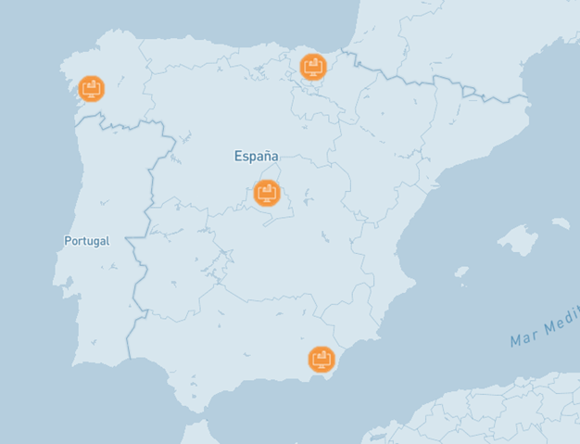
Toolbox. Tecnological solutions
FACTS
Interconections and HVDC
48 reactances (3400Mvar) for voltaje control
STATCOM
(Moraleja 400kV, Vitoria, Tabernas y Lousame 220kV)
OBJECTIVE: interarea oscillations control
3 syncronous condenser in Canary islands
como elementos plenamente integrados en la red de transporte, que permitirán una mejora sustancial en la integración de renovables.
SDC –October 2022

Slide 24

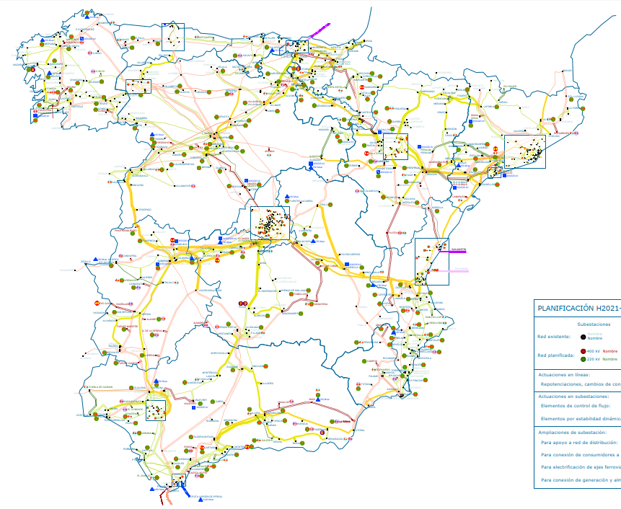

Strategic Environmental Assessment to asess environmental compatibility
16 MONTHS
25 - 26 MONTHS
700 km
renewals
TIMELINE NATIONAL DEVELOPMENT PLAN
7.057 km
upratings
2.681 km
New aerial ROW
TIMELINE STRATEGIC ENVIRONMENTAL ASSESSMENT
734 km
Submarine link
300 km
reconducting
722 km
DLR
24
SDC –October 2022

Slide 25
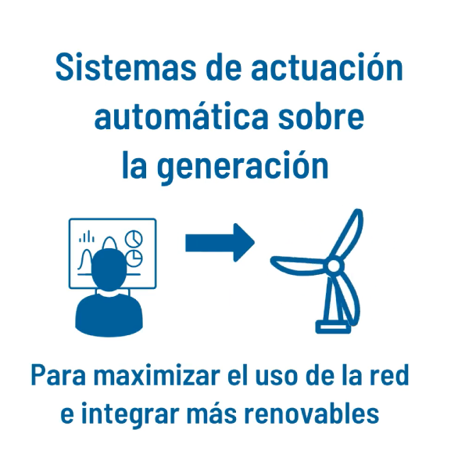
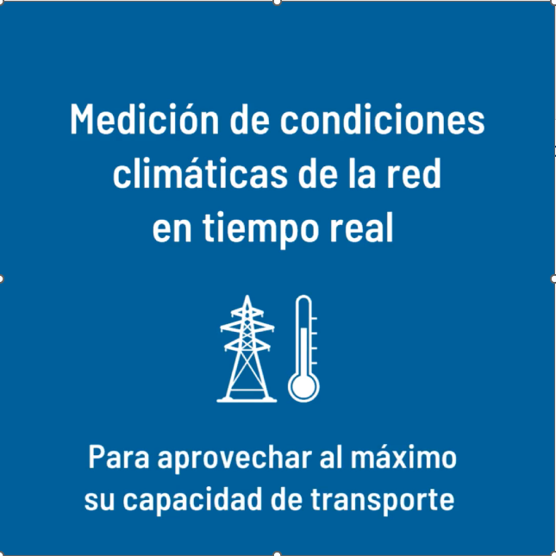
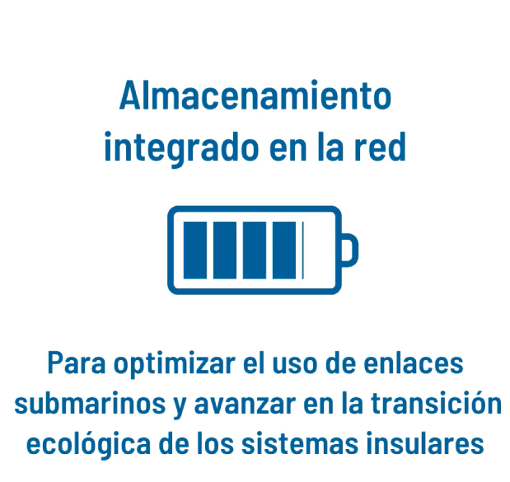

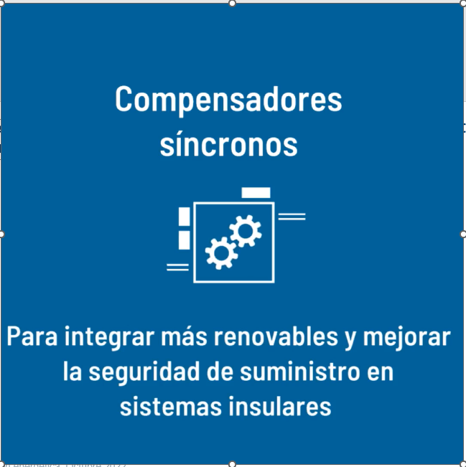
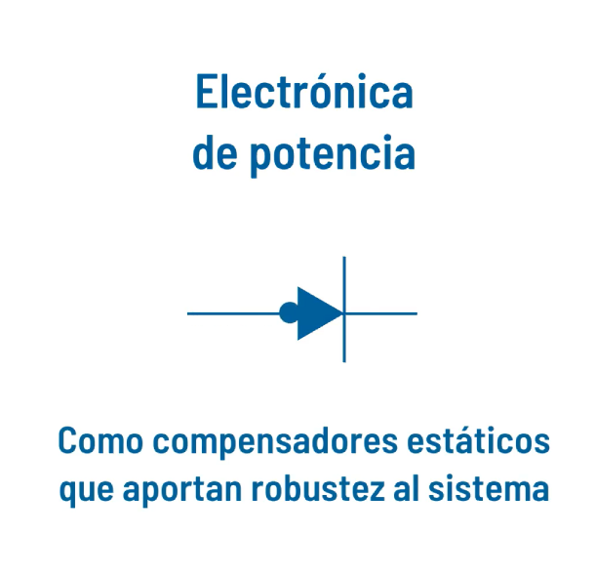
Toolbox of technological solutions
Automatic Power Reduction System
(SRAP)
Real Time measure of climatic conditions
Storage as full integrated network element
To maximize RES integration and use of existing network
To make better use of transmission capacity
To optimize use of submarine links and progress on decarbonization of islands
Synchonous condenders
Power
electronics
HVDC
Enlaces en corriente continua
To integrate more RES and improve the SoS in the islands
As static compensators that give robustness to the system
Para el desarrollo interconexiones eléctricas
Interconnection development
SDC –October 2022

Slide 26

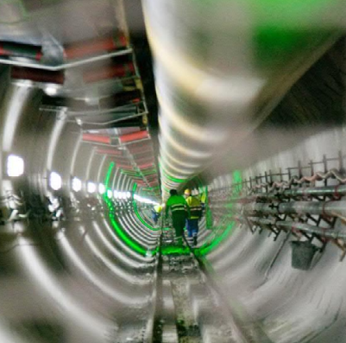

Network Development Plan 2021-2026
Total investment of 7000 M€
Renewable
integration
Systems interconnection
Economy electrification
1872 M€
27 %
International 1260 M€
National 1487 M€
40 %
1549 M€
22 %
SDC –October 2022

Slide 27




Global impact of the Network Development Plan 2021-2026
Benefits for the society
67 % RES in the national mix in 2026
66 % reduction of CO_{2eq} emissions
€
Savings of 1.600 M€/y in variable generation costs
Increase of 4.600 M€ in GDP
Support to 78.000 jobs
SDC –October 2022

Slide 28

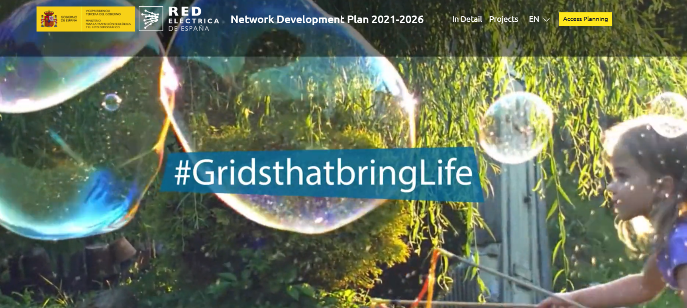
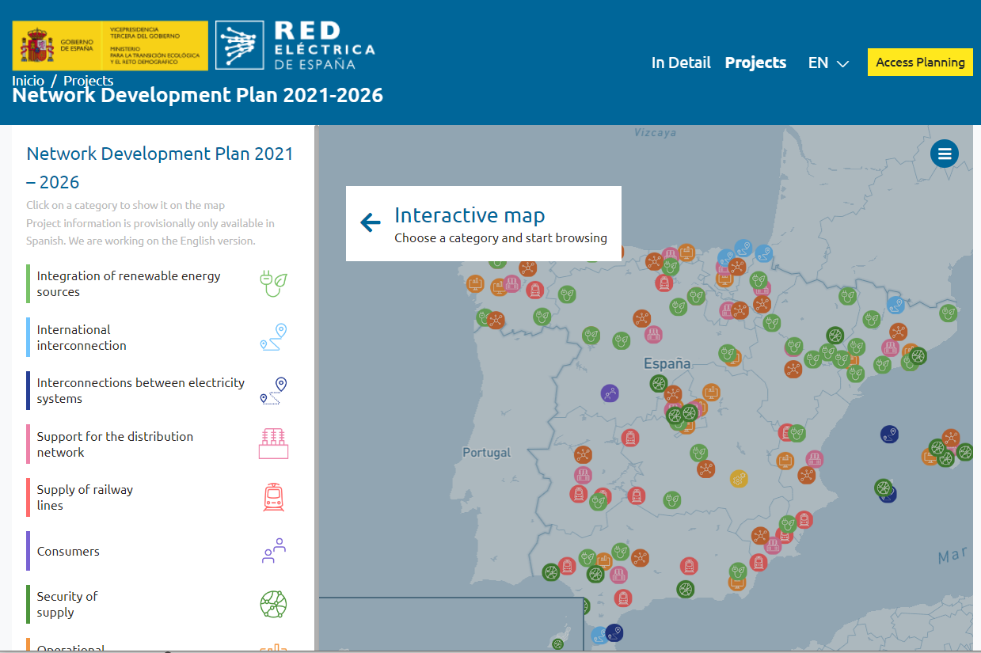
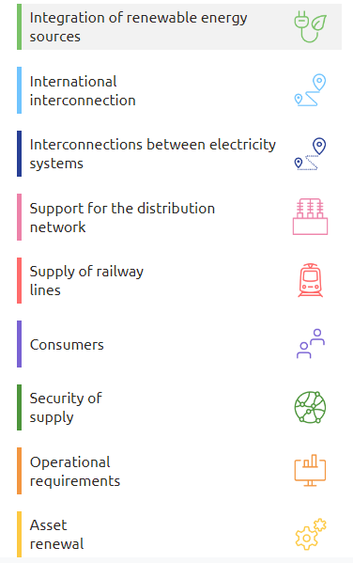
Access to the Spanish Network Development Plan
www.planificacionelectrica.es/en
Webpage:
SDC –October 2022

Slide 29


Conclusions
It is possible to operate a system with a high % of RES although it requires a wide toolkit
Grids are enablers of the energy transition and should be treated like that , and also work on solutions to the barriers for the proper implementation of the right grid at the right moment
SDC –October 2022

