Slide 1
Reconciling Biodiversity and the Grid
Liam Innis, Manager – Energy Ecosystems
Connecting Energies Workshop, September 2023
Notes:
Thanks . LIAM INNIS
Thanks for showing interest in this important topic
Glad we can support and share our knowledge
Please consider - you can always reach us!
If there's one thing we've learned, it's that - together, we are powerful. Sharing knowledge, building unlikely coalitions, really does make a difference.
Complement the past presentation with a reflection of the importance of considering biodiversity alongside the grid – and the many solutions available to us

Slide 2




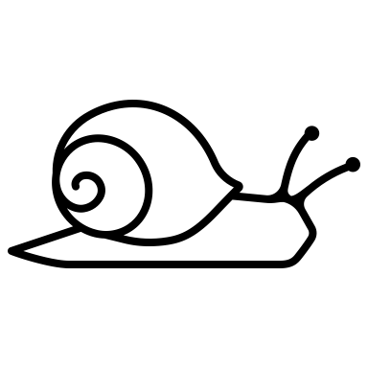
Climate vs. biodiversity?
Notes:
You're all aware, we face not only the climate crisis, but a biodiversity crisis.
Often, even within civil society circles, these two are pitted against each other - as if we can only pursue one of the goals of climate action / biodiversity conseration/restoration at a time.
This is a false dichotomy, and indeed a very dangerous one.
It’s clear - to shift away from fossil fuels to an energy system based entirely on RES
So we must build build build
HOWEVER - clear that we can't just build here there and everywhere.
It's clear that infrastructure will have impact wherever it is built
This must be considered and prioritised
Especially key nature is already in dire straights
Europe - 81% of species have poor (45%) or bad (36%) conservation status (https://www.eea.europa.eu/en/topics/at-a-glance/nature/state-of-nature-in-europe-a-health-check/habitats-and-species-latest-status-and-trends)
Global - Average decline of 69% in species populations since 1970 (https://livingplanet.panda.org/)
Nature is extremely fragile - pushing it any further is not an option
SO: We must develop strategies to reconcile energy and nature
Not just philosophical targets, but:
Political targets, e.g. Nature Restoration Law’s binding restoration targets and huge acceleration of the energy transition.
You’ve already been introduced to RGI – this is one of our focal points – to investigate and promote methods which unite nature and energy
Let’s accelerate the energy transition in harmony with people and nature

Slide 3
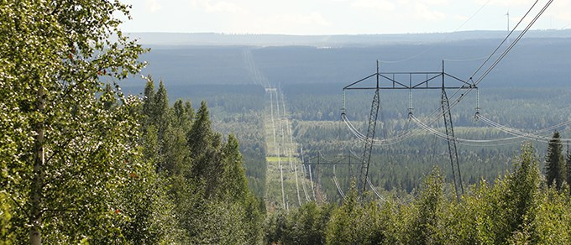
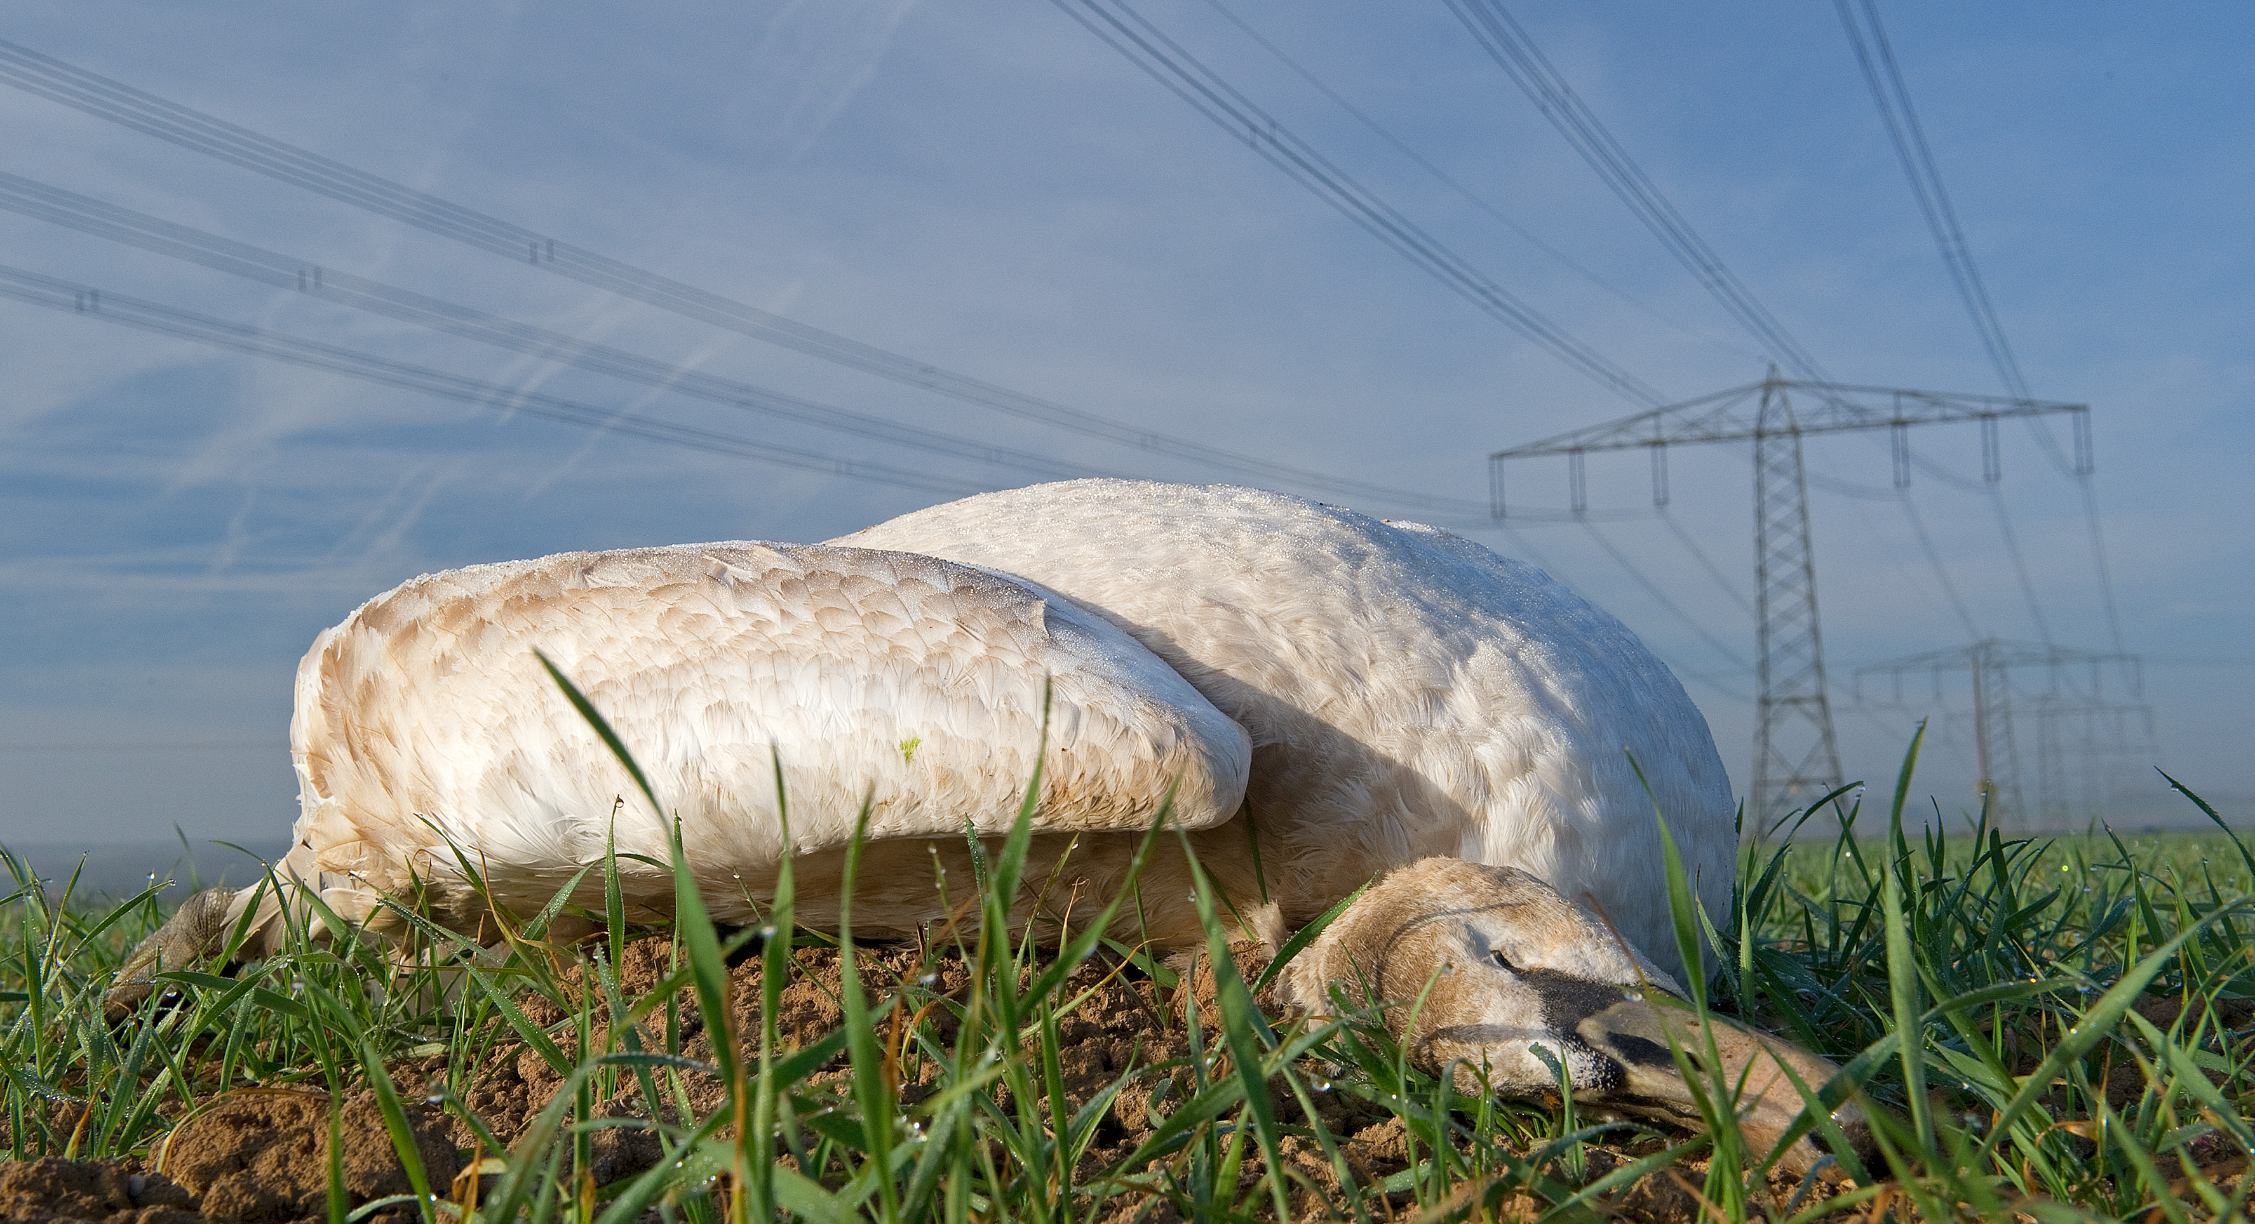
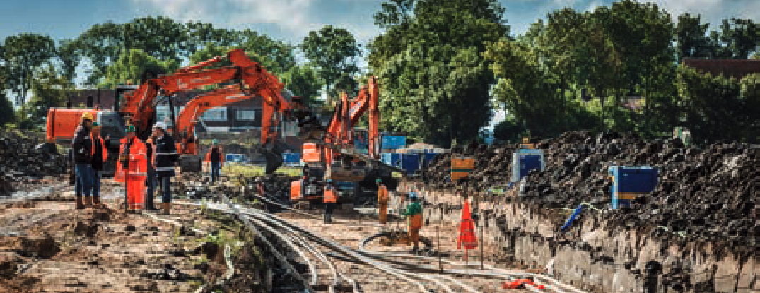
Potential risks of the grid
Disturbance of ecosystems
  Construction, operation, maintenance
Risk to avian species
  Collision, electrocution, disturbance
Underground cables
  Not necessarily a silver bullet
© Delpho
Notes:
This is just an overview slide! We’ll get into more details
Sheer dimensions of the grid - complexity of its components, and prevalence across the landscape – bring potential risks for nature:
1) It can have impacts during construction, in certain operational processes (e.g. vegetation management, maintenance) but also just in being there…
Construction – have to remove trees, use heavy machinery…
Operation – vegetation management - remove & clear trees
Maintenance – again enter ecosystems with machinery (e.g. helicopters)
2) Shared Airspace – explain more
12-64 million birds killed each year at US power lines (Loss et al. 2014)
UNSECURED powerlines pose a real threat to some species
3) Placing power lines underground has been identified as the most effective solution to many impacts on nature (esp. birds)
However, this is not always possible - for a number of reasons, not a silver bullet

Slide 4
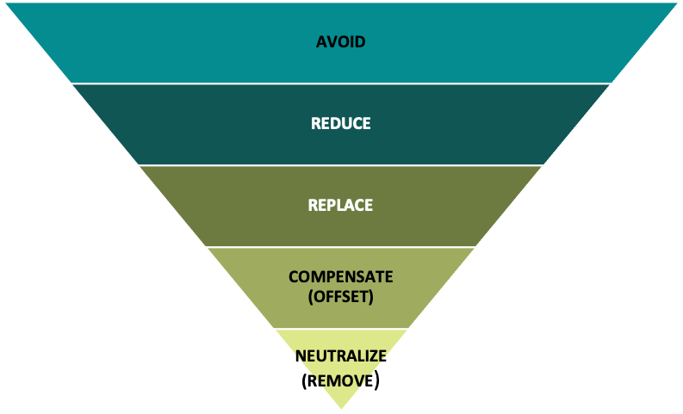
Mitigation heirarchy

Slide 5
Solutions - Standard
Grid operators carry out/contract surveys of ecosystems & species
SEAs and EIAs
Public & NGOs are consulted
Compensation measures for affected communities
Vegetation management to remove black-out & fire-risk
Mitigation measures to lower risk (varies widely)
Main purpose: Ensure safe, continuous supply of electricity
Notes:
Slide will discuss the measures taken by grid operators to mitigate risk on biodiversity
These are the standard solutions which are regularly implemented by grid operators to deal with impacts on biodiversity
Focus is on delivering electricity with least possible impact on nature

Slide 6
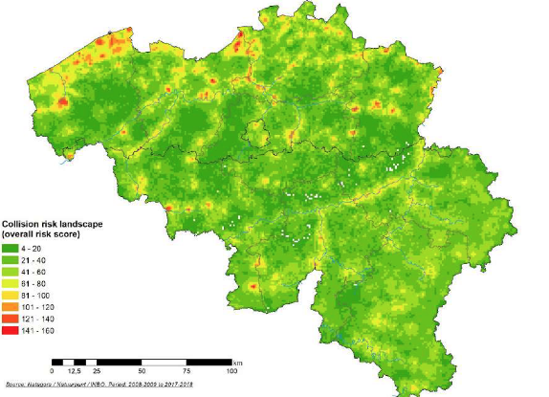
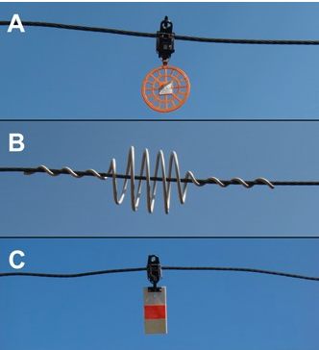
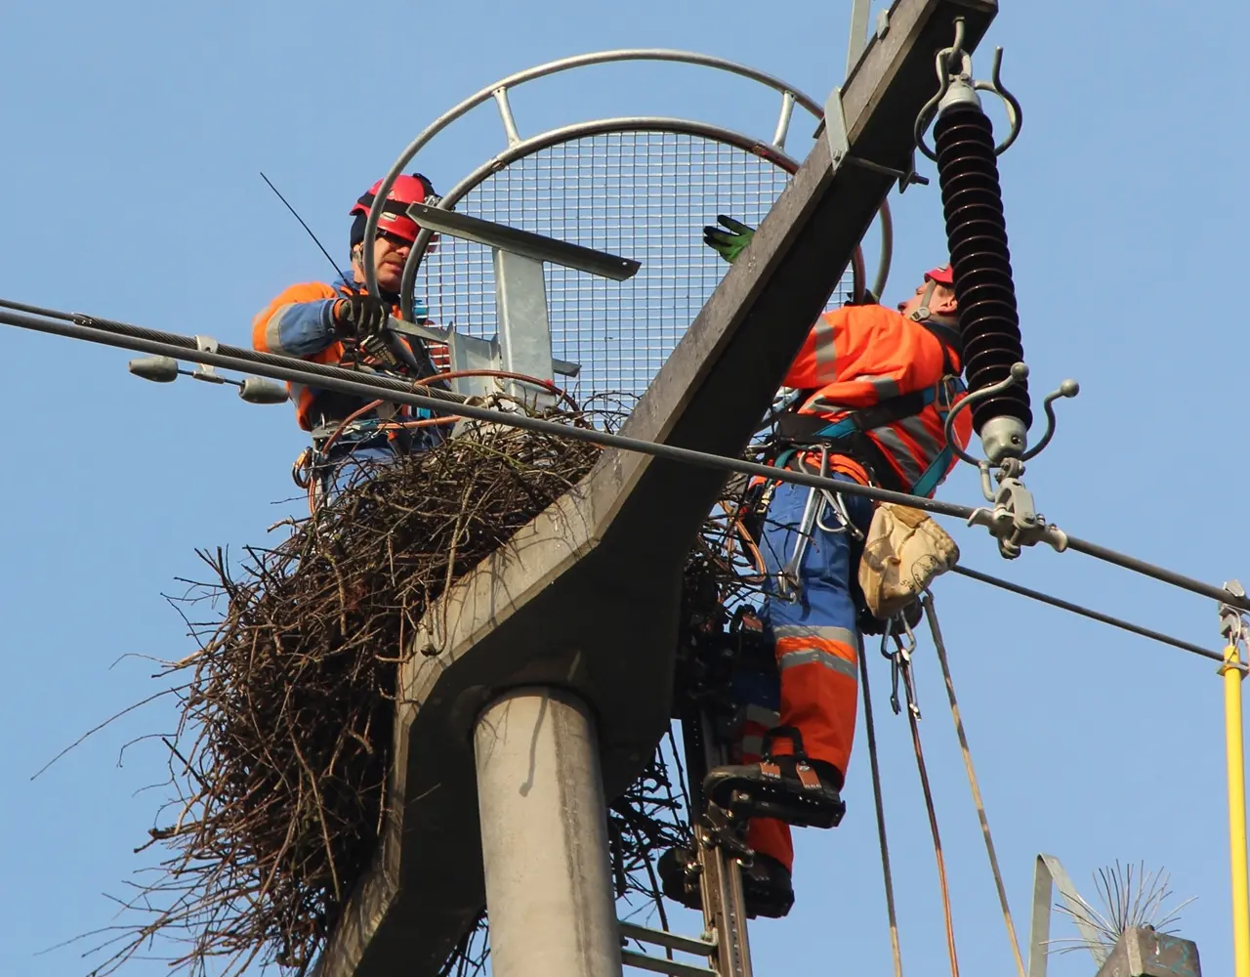
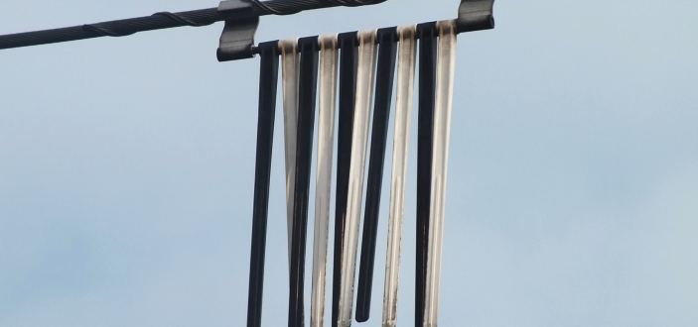
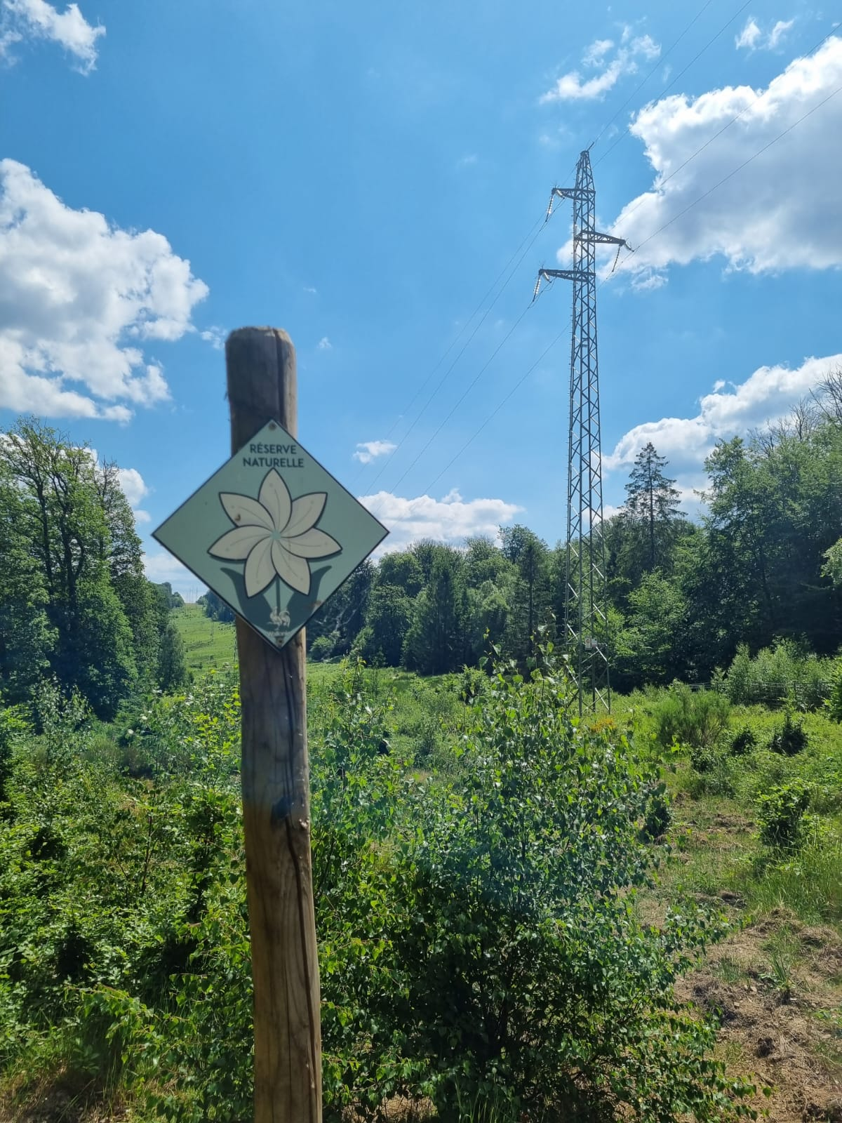
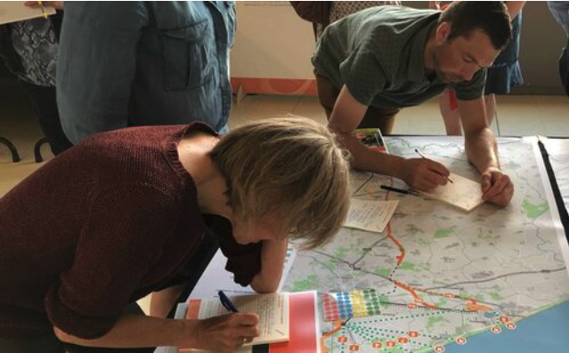
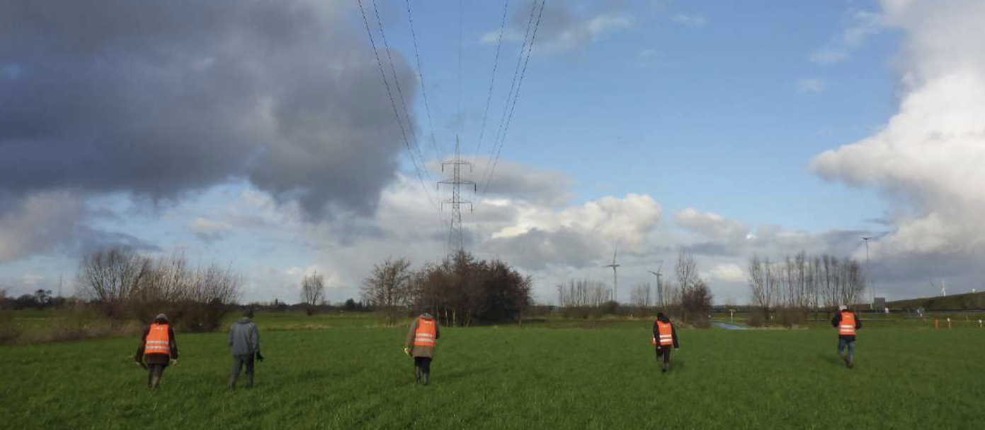
Solutions – Best practice
Sensitivity mapping
Tailored mitigation measures
Nature-inclusive design & management
Collaboration with civil society
Project support groups
Open data approach
Paradigm shift – participation, nature-based planning, multi-use
Get involved! ☺
D
Notes:
These are examples of best practice approaches to biodiversity around the grid – which go above and beyond the “standard” to pro-actively and collaboratively look for solutions.
Example for each, e.g.
Sens mapping: Belgium case – Collaboratively done…
These are all ways that you as NGOs can engage.
Sharing your knowledge = design even better practices.
More practices? Flag them to us!
Reality of NGO life = often not funding/capacities for such endeavours.
If funding is the reason, get in touch!! We know grid operators who do have funds/time and we can help realise new projects
Focus on collaboration, data for more refined and integrated planning, considering nature and ecosystems at the planning level
These kind of practices also hint at a kind of mentality shift.
Beyond looking at grid as grid, but seeking to capitalise on its assets to benefit others
e.g. as nature restoration jobs for local people to scout & combat fires

Slide 7
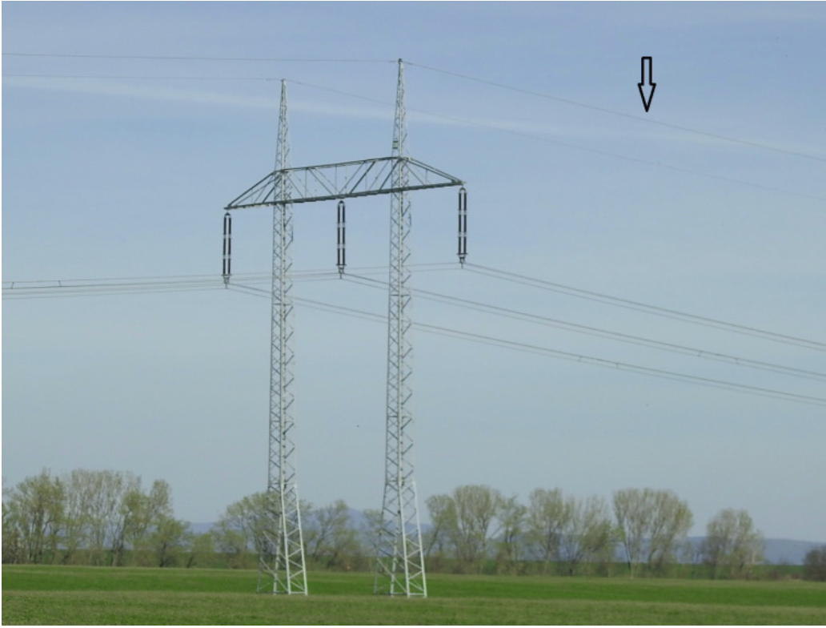
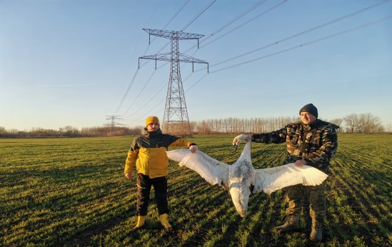
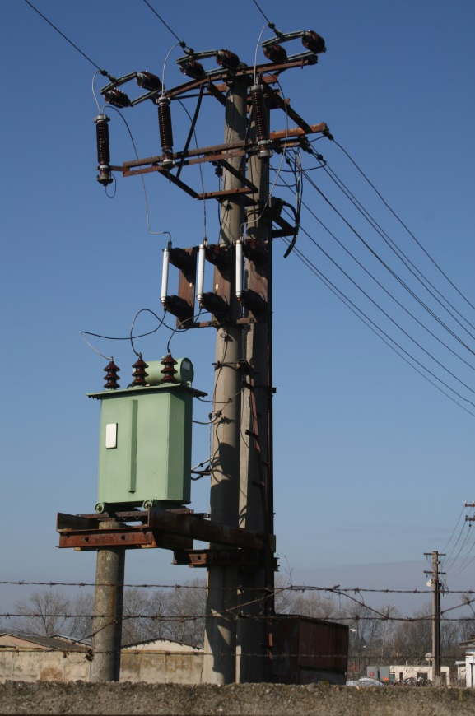
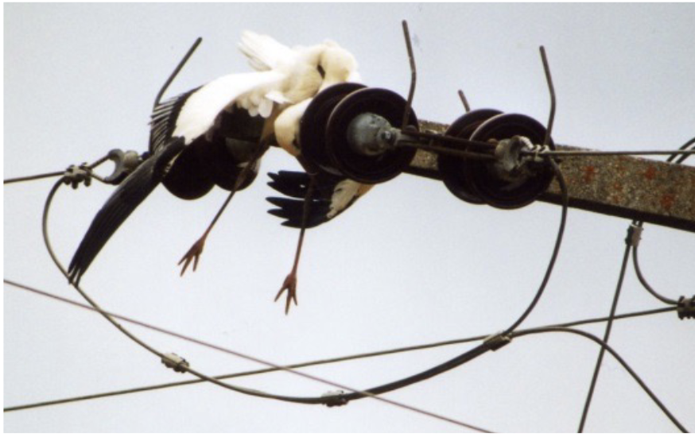
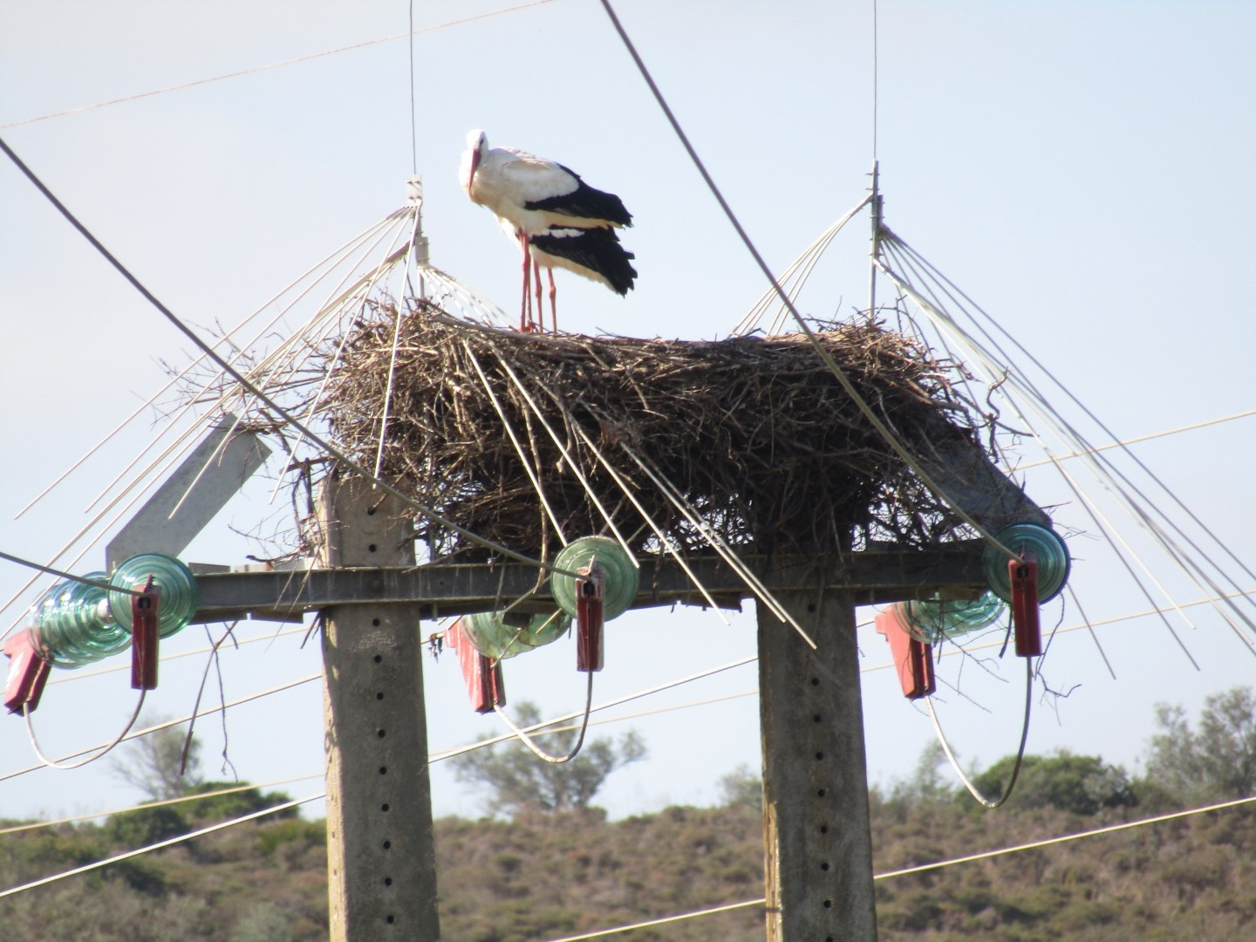
Birds and the grid – The problem
© RPS
Collision
Mostly with thinner ‘earth wire’
Larger, heavier birds with short wing spans & poor vision
Electrocution
Birds on a wire = not the problem
Poles/pylons = attractive perches & observation points
Especially on medium voltage power lines (shorter distances)
Can cause outages & fire
Disturbance
Maintenance operations (e.g. helicopter) can impact breeding species
Nest abandonment, unsuccessful breeding
Data
No standardisation in monitoring
Unclarity on where to store data
Notes:
Collision is an ongoing threat and contributes to declines in several species of cranes, bustards and diurnal raptors.
Electrocution is critical threat to some vulture species.
Also economic threat (from outages) and risk of fire! Action is a win-win for biodiversity and the power sector

Slide 8
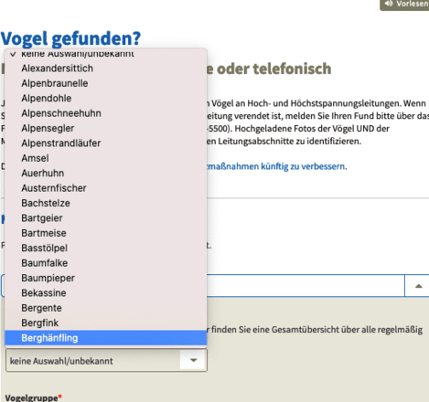
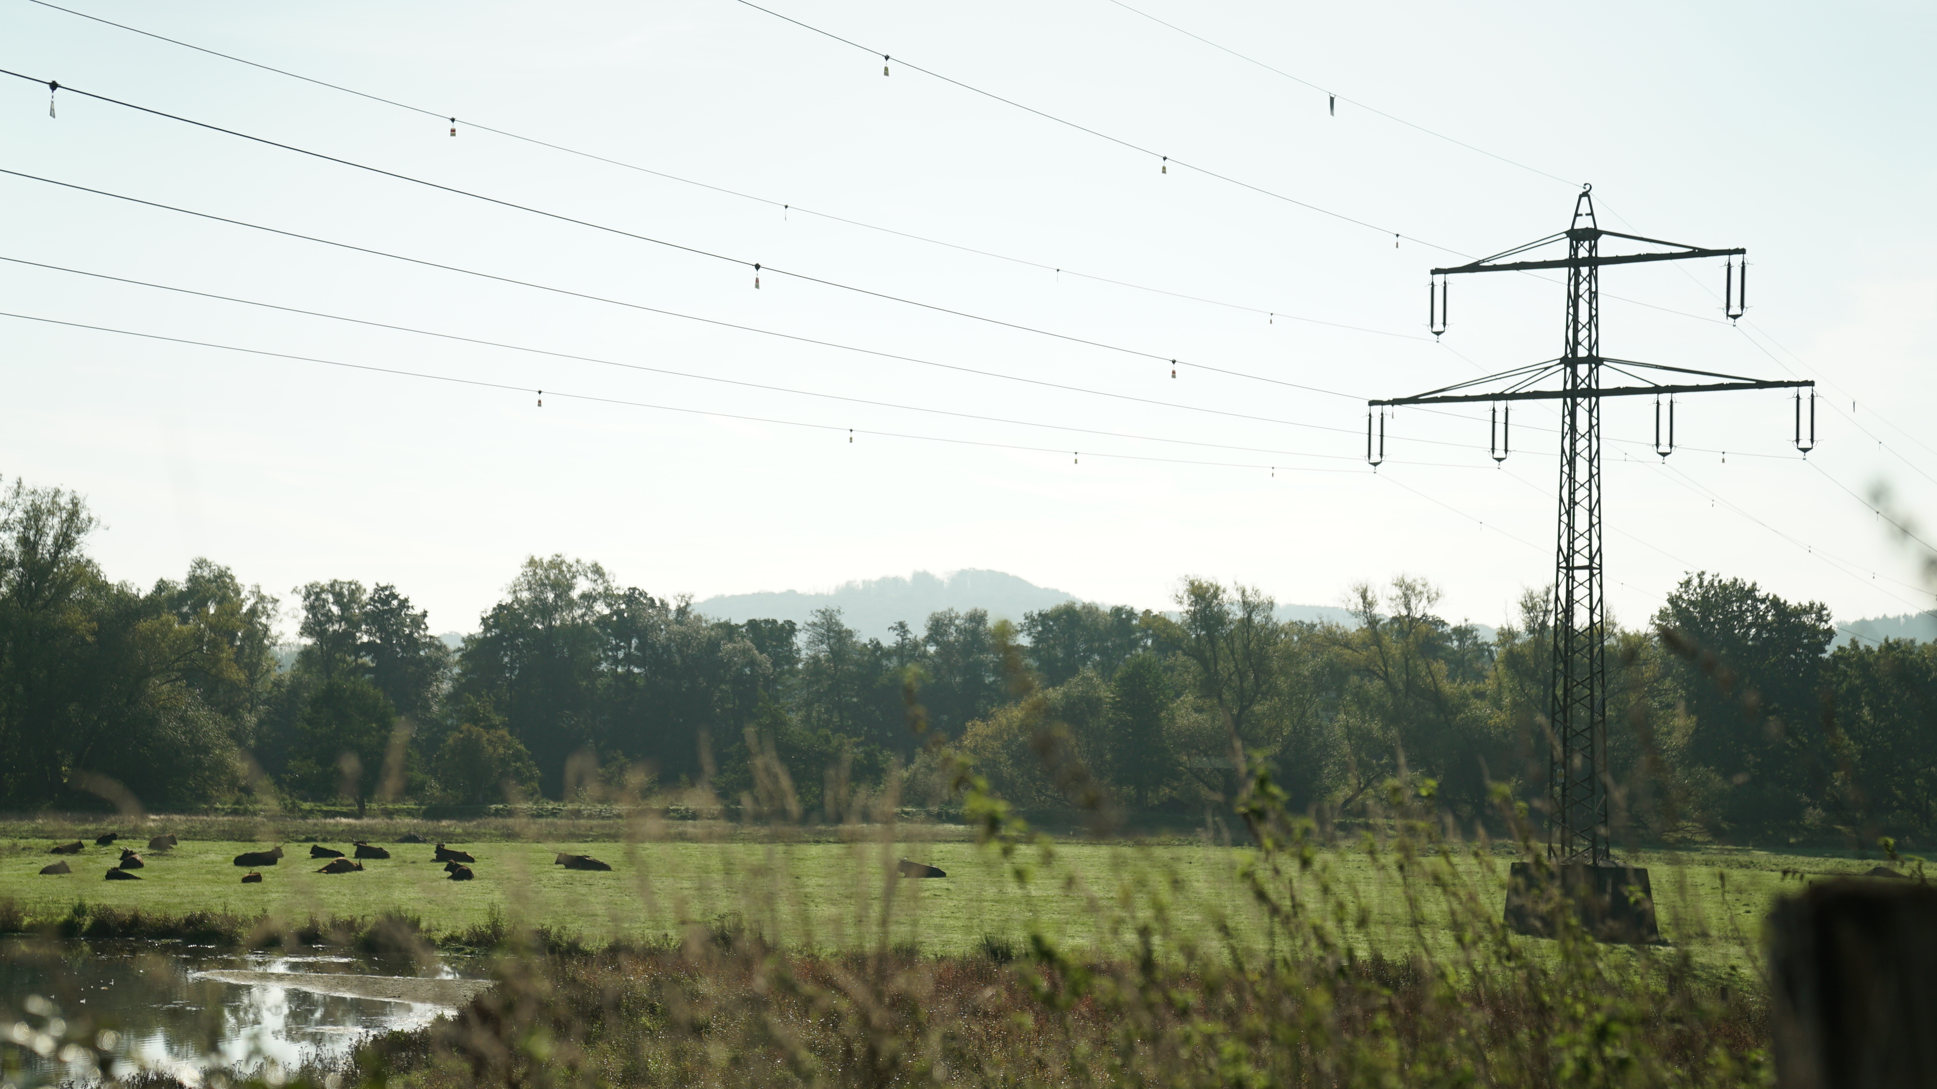
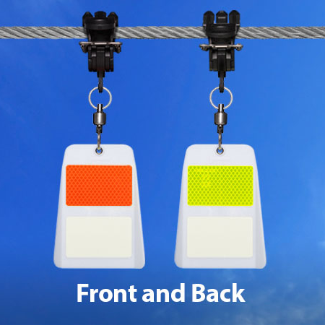
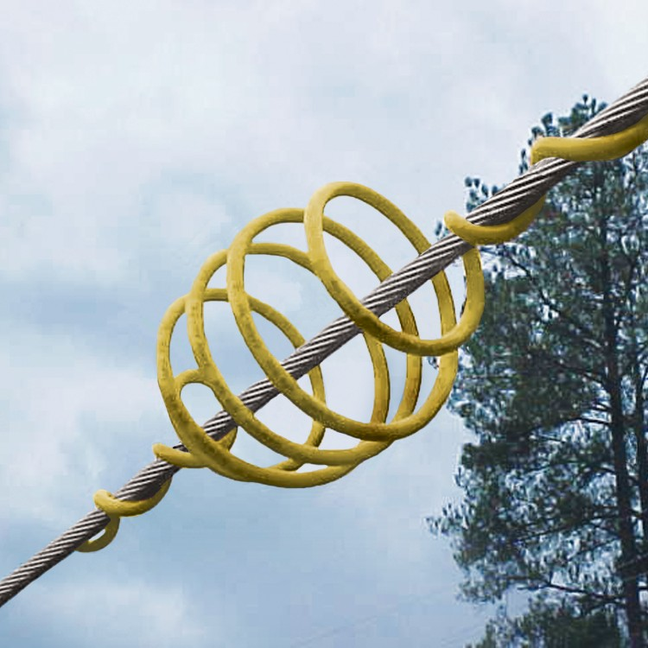
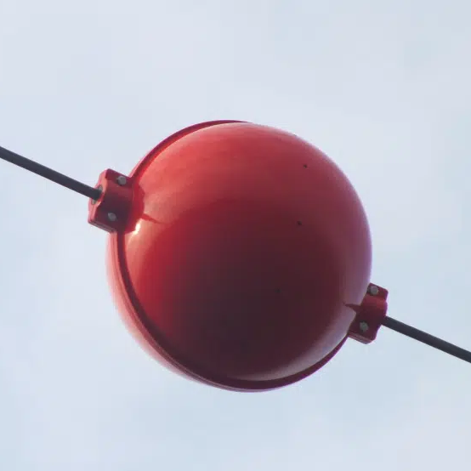
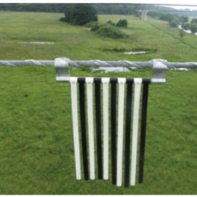
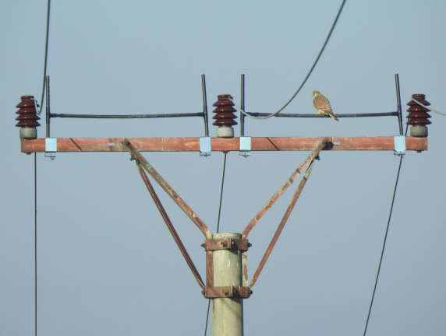
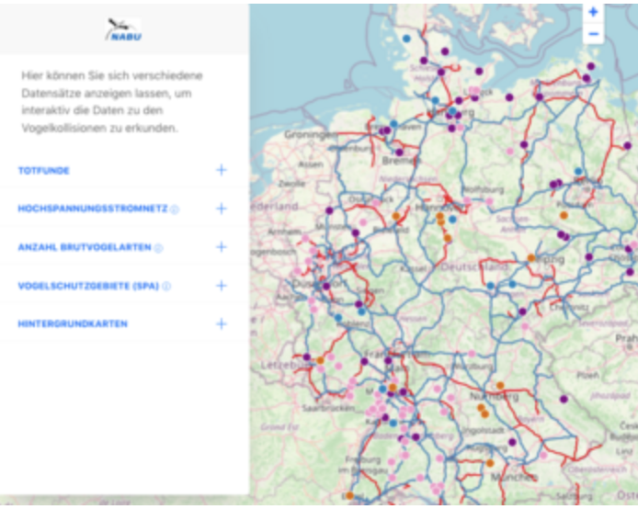
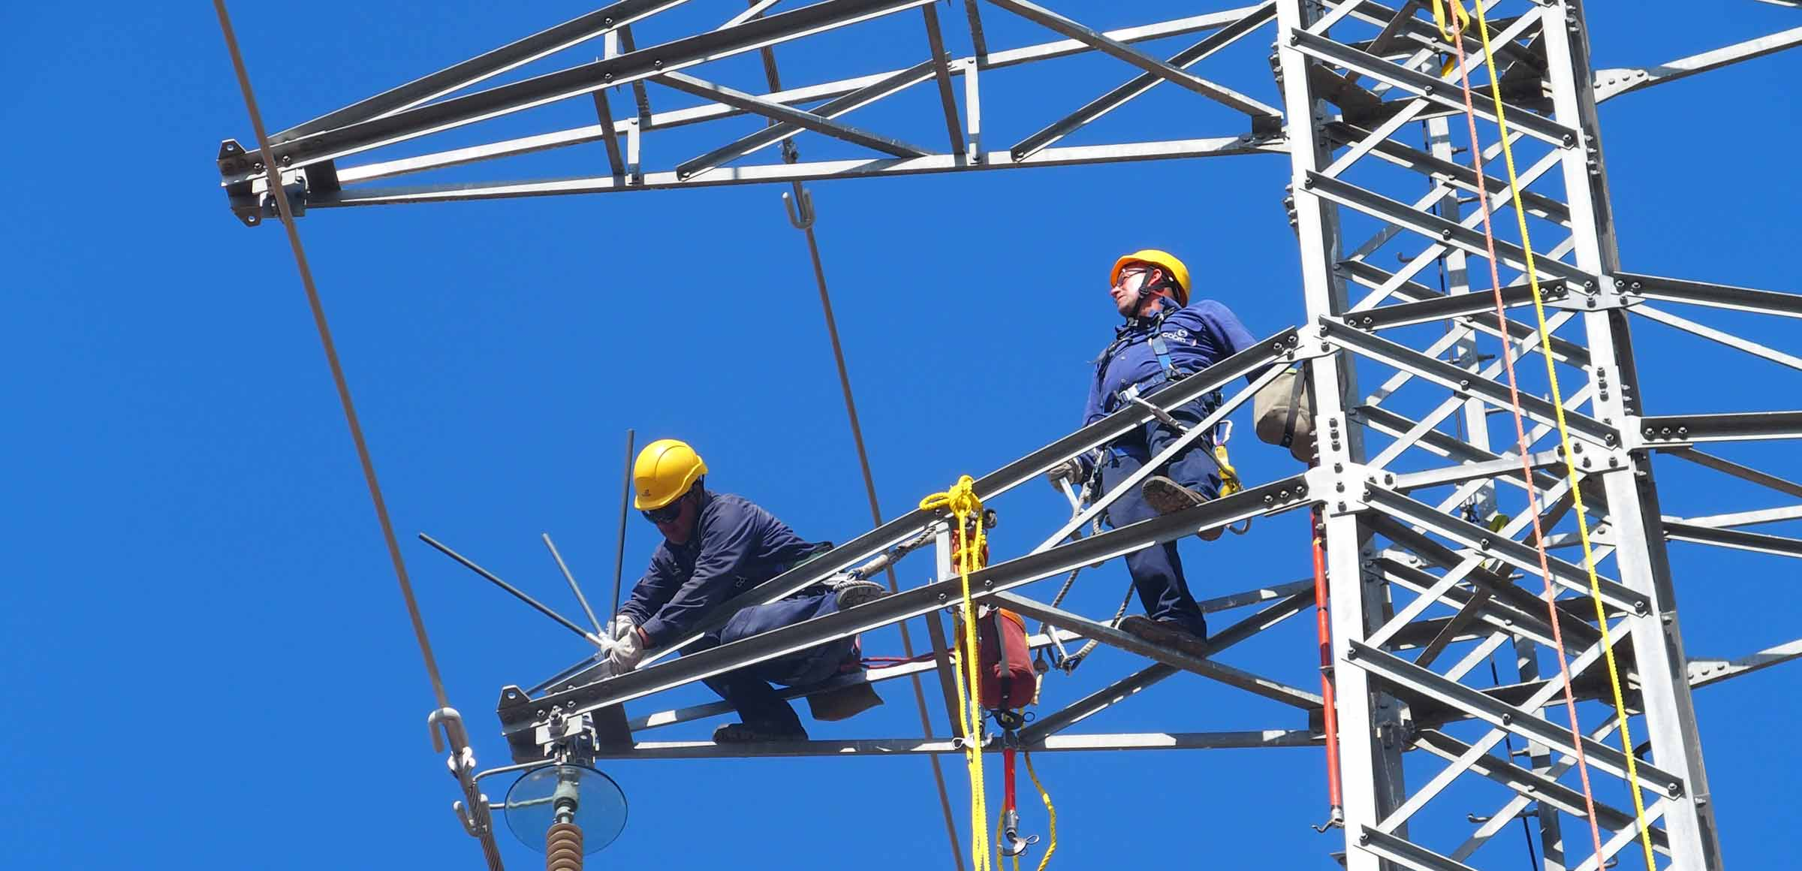
Birds and the grid – The solutions
Collision
Identify hot spots with sensitivity maps
Bird Flight Diverters to make lines visible
Placing power lines underground
Electrocution
Mitigation to allow safe perching (e.g. insulation, nesting boxes)
Replacing dangerous, poorly design poles
Underground cables
Disturbance
Adapting schedule in line with breeding periods
Place nest supports away from assets
Data & Monitoring
Citizen science
Open-data, data sharing
  E.g. Collaborative databases!
Notes:
Collaboration with NGOs for various approaches already mentioned
e.g. sensitivity mapping

Slide 9
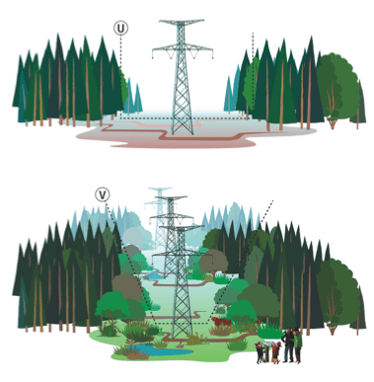
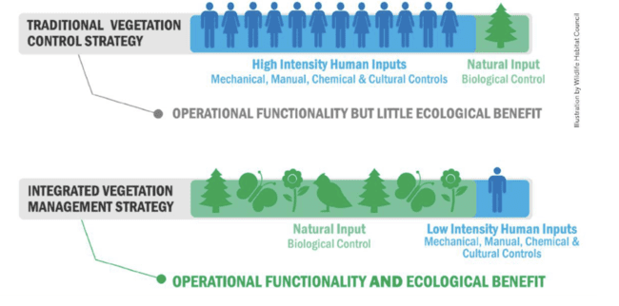
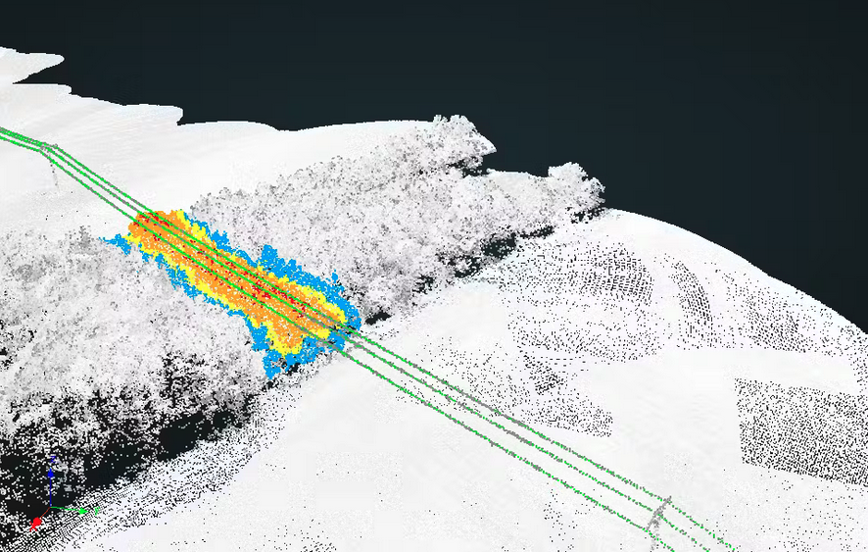
Integrated Vegetation Management (IVM)
VM: system security & fire prevention
Periodical, indiscriminate clearance of grid corridor, mech. & chem.
Result: Recolonisation, ‘No-mans’ land’, dispossession, high costs
IVM (aka. ECM):
  Nuanced approach
  Selective removal
  Natural processes
  Opportunities for local stakeholders
  Can be tech-supported

Slide 10
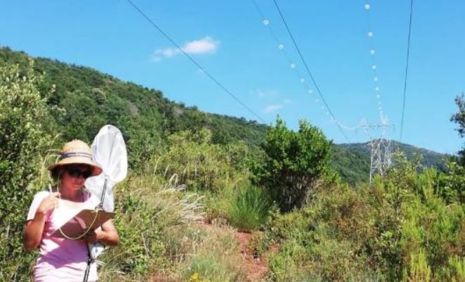
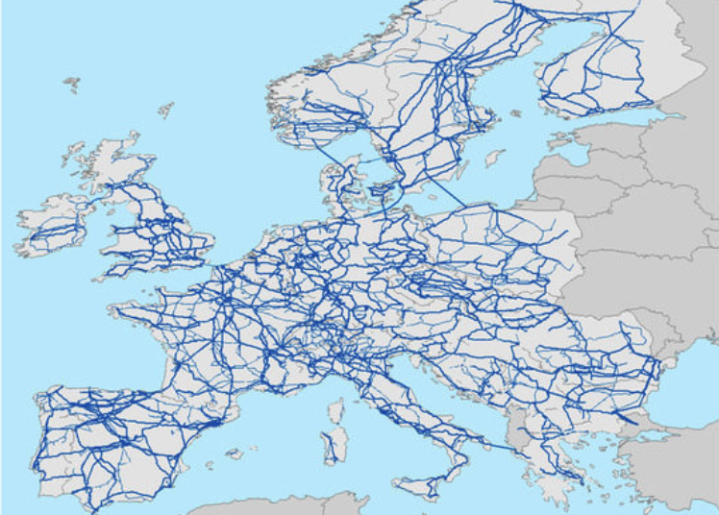
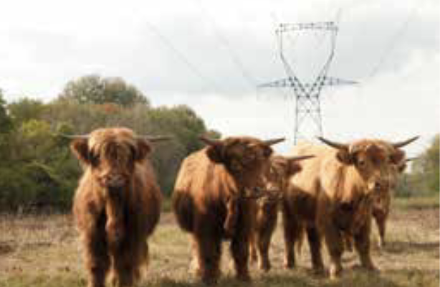
Integrated Vegetation Management (IVM)
Beneficial for local biodiversity
  Floral diversity = Habitat, forage e.g., for invertebrates, reptiles
  BE: 82% good or exceptional ‘biological gain’, 1-10% of overall Natura 2000 surface
Interconnectivity - Species population viability
  “Continental scale networks of biodiversity¹”
Combat invasive species & reduce fire risk
Long-term cost benefits
  1.4 - 3.9x cheaper²
Rural benefits & value creation
  Access to pasture, new income streams (e.g. mgmt., bee-keeping), hunting*
Public acceptance of infrastructure
1: Ferrer, Miguel, et al. (2020). "Transporting Biodiversity Using Transmission Power Lines as Stepping-Stones”
2: LIFE Elia-RTE (2017) “A Cost-Benefit Analysis of an Alternative Vegetation Management”
Notes:
Beneficial for local biodiversity
Species population viability
1.4 - 3.9 x cheaper
Rural benefits & value creation
Good for public acceptance
of infrastructure

Slide 11
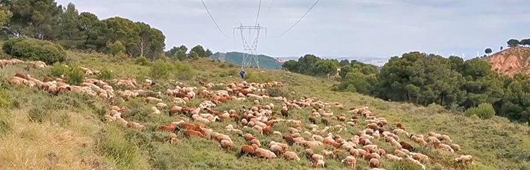
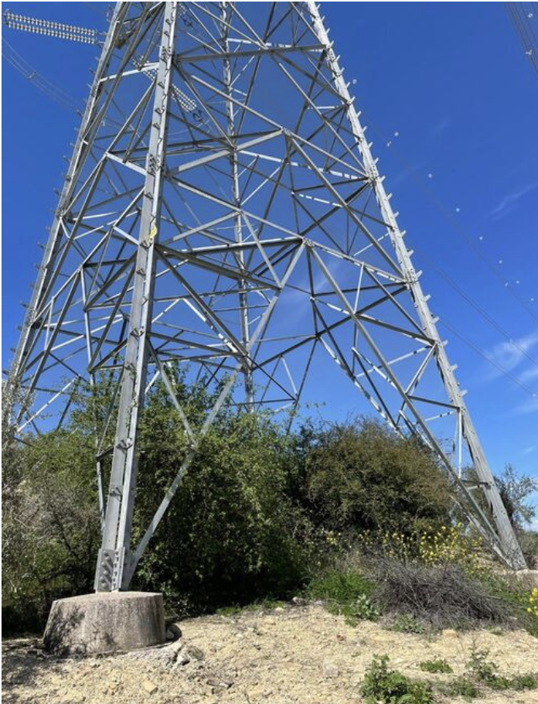
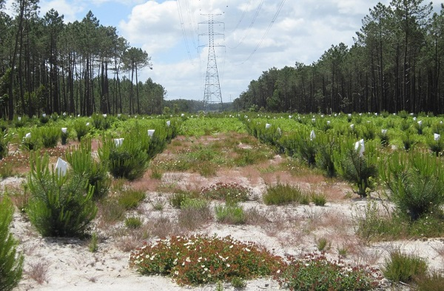
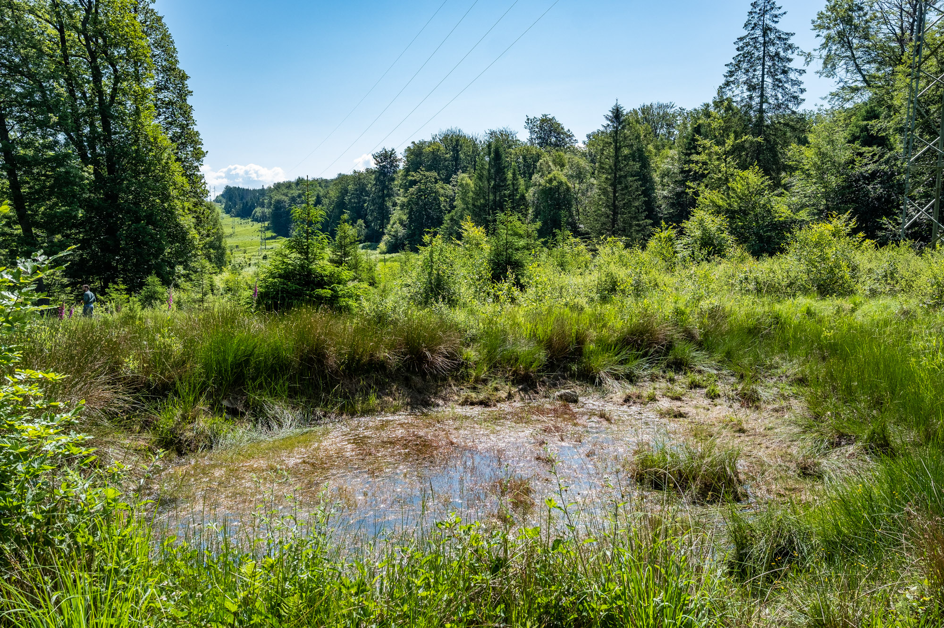
IVM Examples

Slide 12

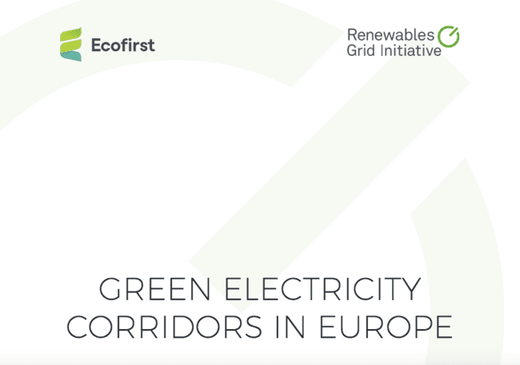
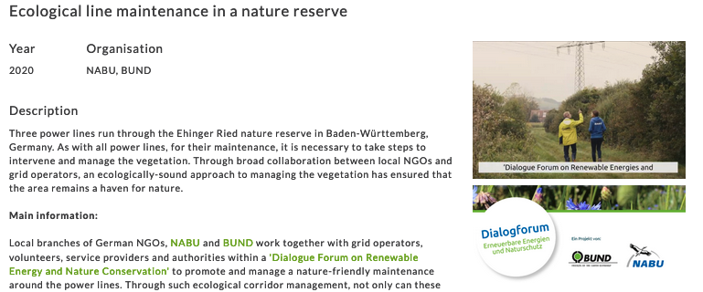
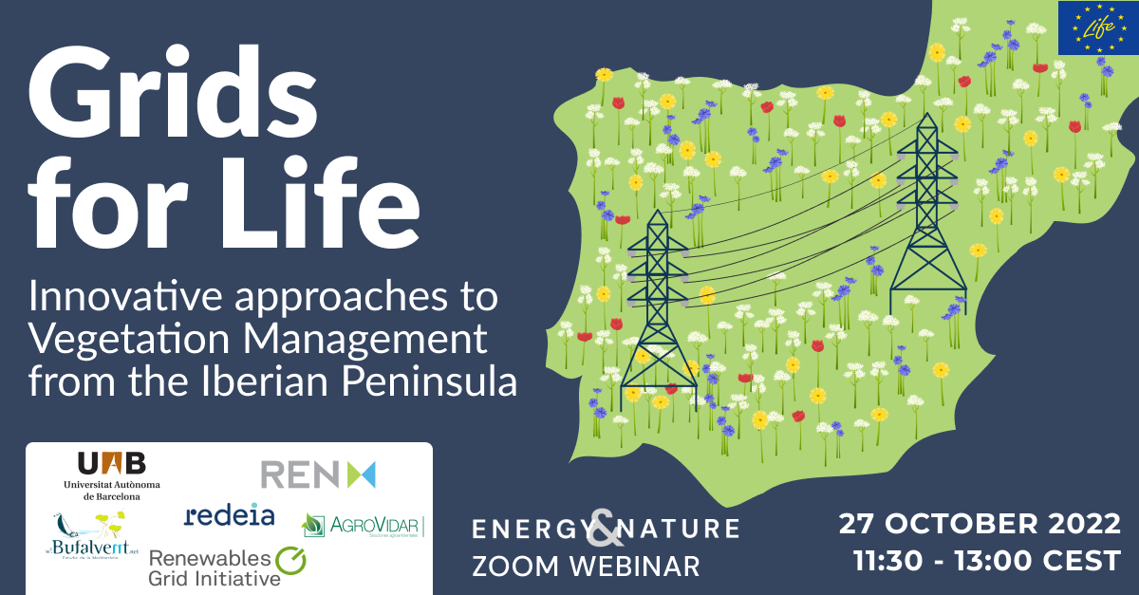
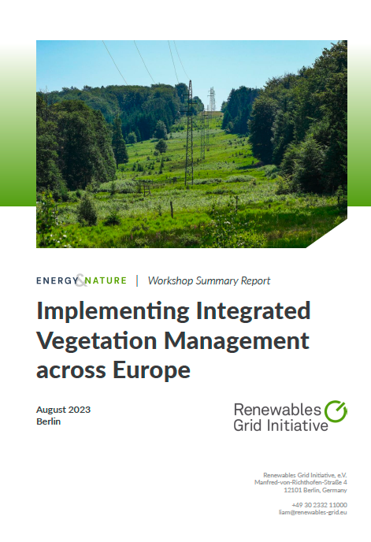
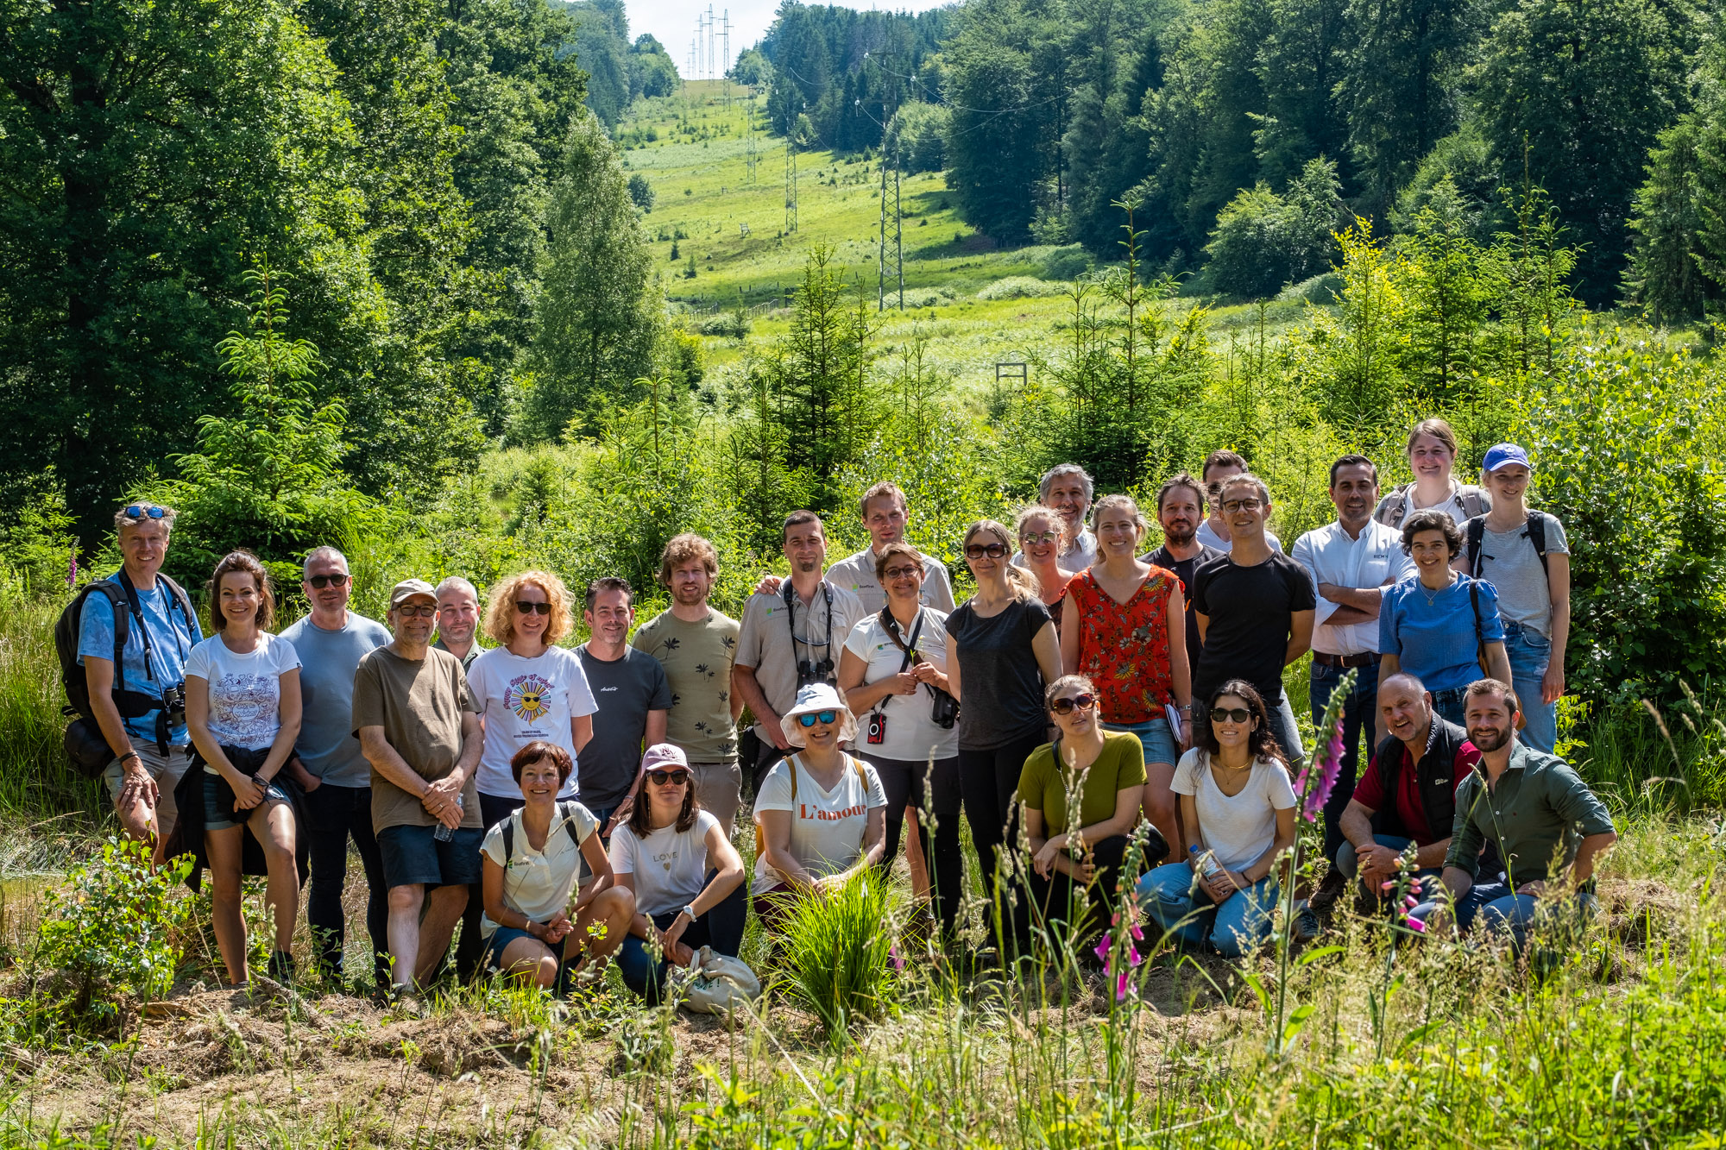
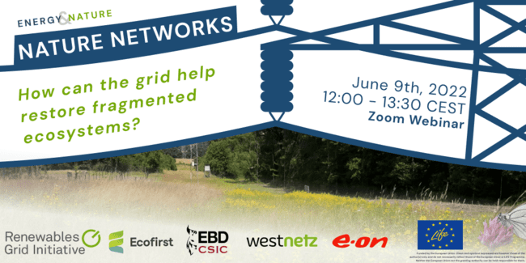
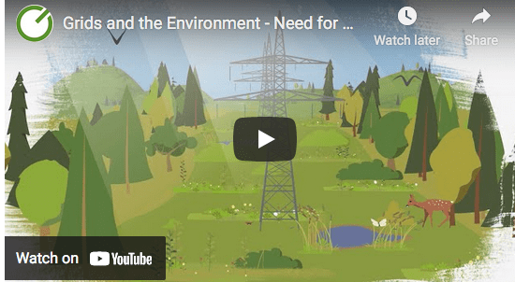
RGI work on Green Corridors & IVM
Briefing paper 2019
Webinars
Best Practice promotion
2023: Workshops & Working Group
Video & communications

Slide 13
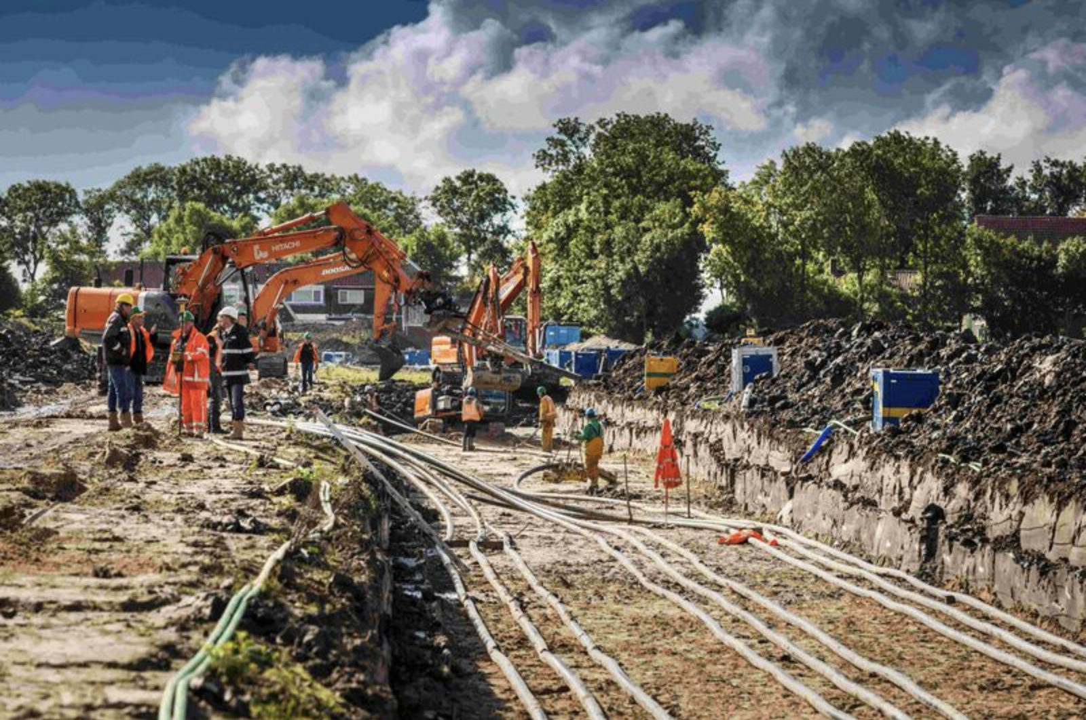
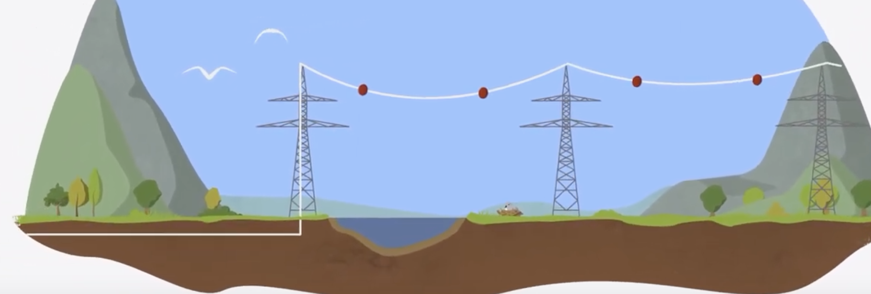
Underground cables
Positive
Removes collision & electrocution risk
Can bring more acceptance = faster deployment
  Depends on stakeholders!
Less impact on landscape
Negative
Significant cost increase
(installation & maintenance)
AC = technological challenges
Not universally possible, e.g. wetlands
Can disturb soil & species
Temperature effects

Slide 14
Key takeaways
Climate & biodiversity crises can be tackled together!
  Reconciliation of grid and biodiversity is possible
Good planning is better than mitigation
  Collaborative, nature-inclusive, transparent
Civil society participation is vital!
  Formal consultations, new exchange fora, joint planning & management
Action on biodiversity is a win-win-win situation

Slide 15

Thank you!
+49 30 7677 194 50
liam@renewables-grid.eu
www.twitter.com/renewablesgrid
www.renewables-grid.eu

